Slide 1
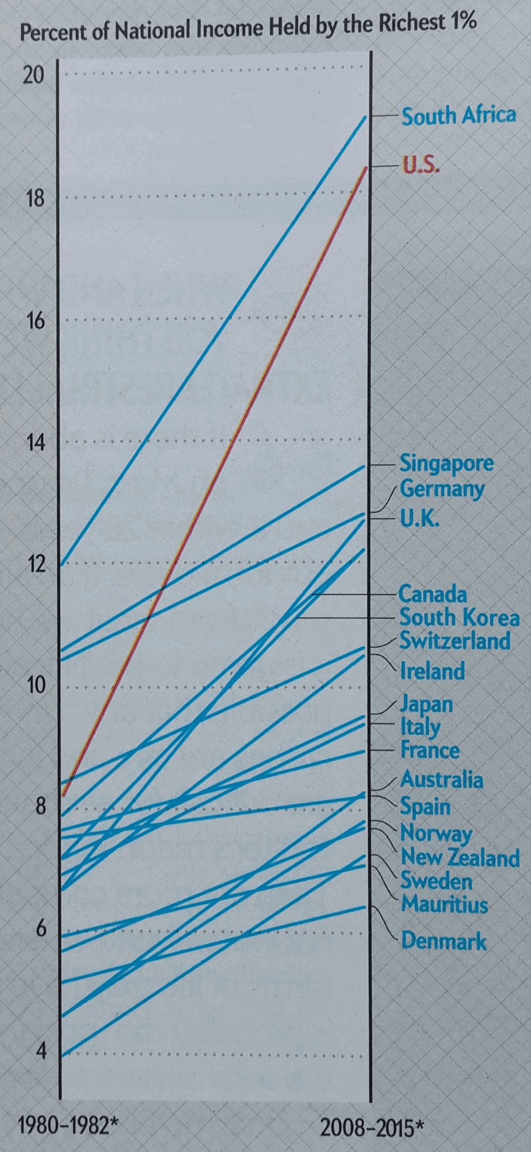
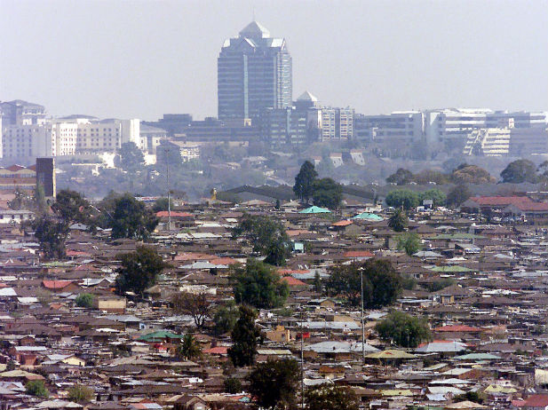

PRESENTATION AT THE 8TH ANNUAL BUILDING CONTROL OFFICERS’ CONVENTION– City of Johannesburg,
November 22, 2018
SUSTAINABLE BUILT ENVIRONMENT AND CITIES: COLLABORATION AND PARTNERSHIPS FOR HOLISTIC OUTCOMES
Prof Daniel Irurah
Sustainable Architecture & Cities
School of Architecture & Planning
University of the Witwatersrand – Wits
“We Shape Our Buildings, Thereafter, Our Buildings Shape Us”:
Winston Churchill – October 18, 1943

Slide 2
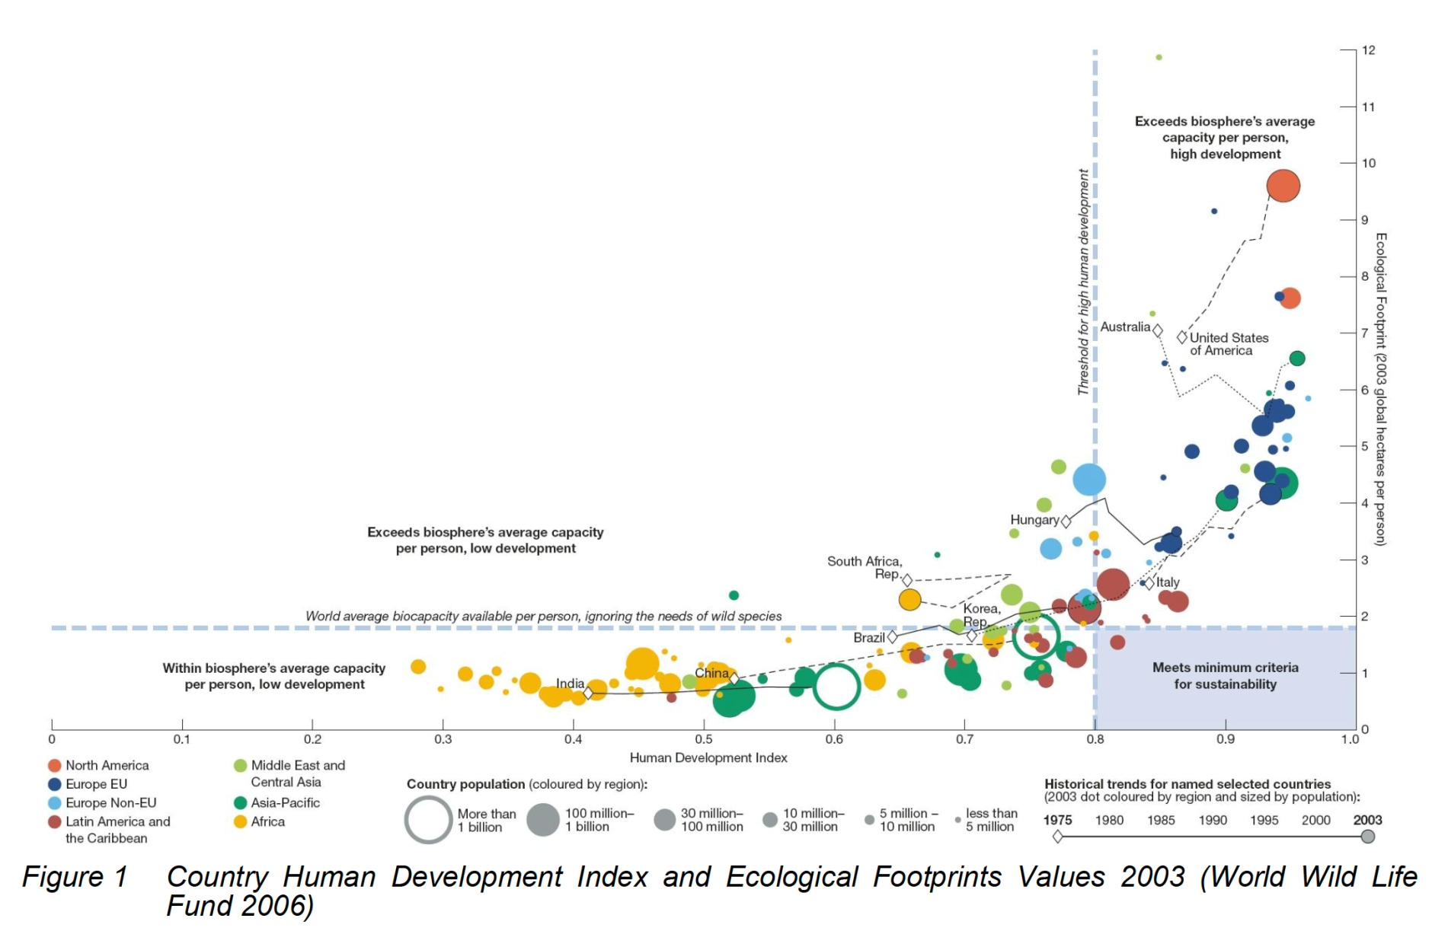
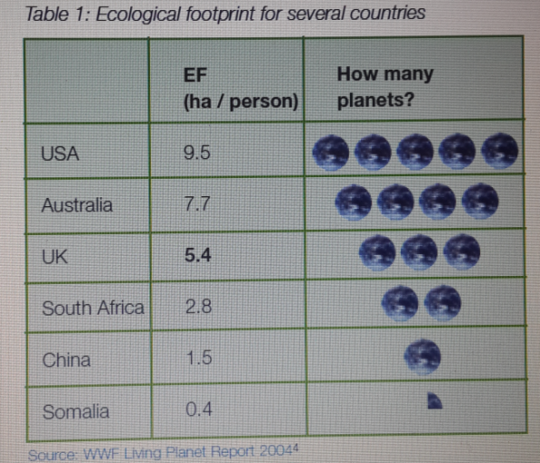
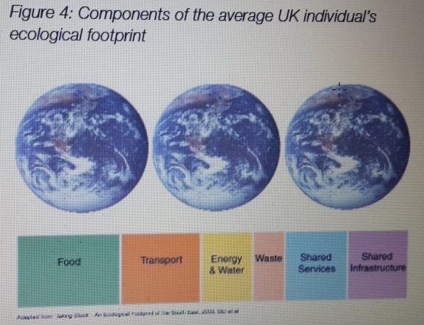
CHALLENGES & URGENCY: Planetary Thresholds Overshoot & Call to One-Planet-Lifestyles

Slide 3
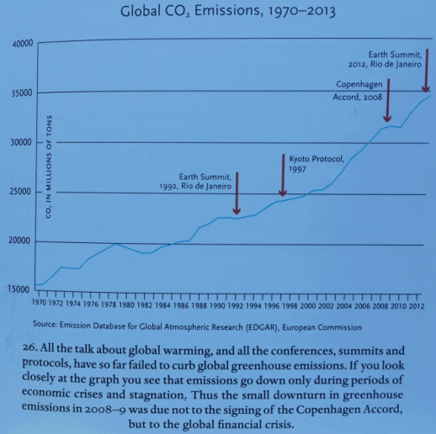
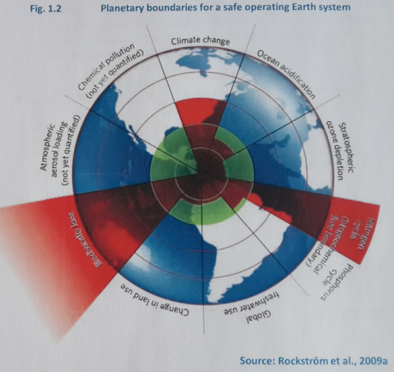
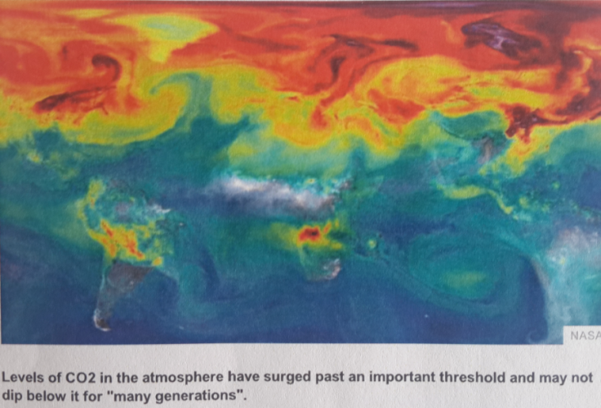
CHALLENGES & URGENCY: Planetary Thresholds Overshoot & Call to One-Planet-Lifestyles

Slide 4
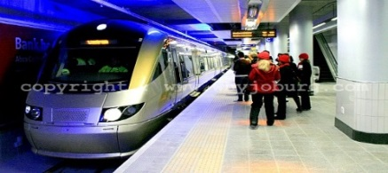
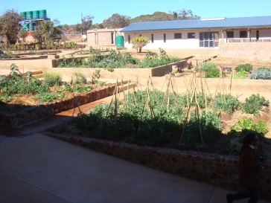
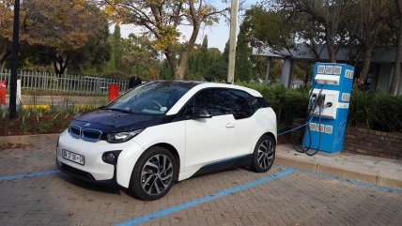
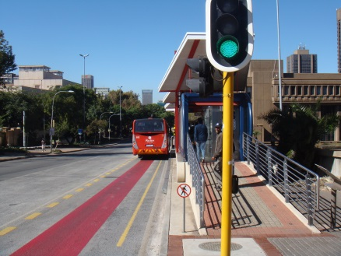
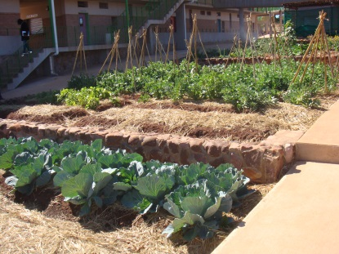
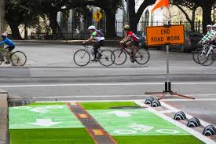
PATHS, PROCESSES & EXPERIENCES: Socio-Technical Interventions Within 3Ps Principles: People, Place, Planet
PEOPLE: Aspirational & Fulfilled | Eco-Innovations & Green City Start-Ups | Speed-trains and BRT Dense Urban Form | Permaculture & Roof-Top Gardens | Cleaner-Fuels & Non-Motorised commute
 | Creative & Resourceful –Creative & Innovative Enterprises, Enhancing Green-Economy value-chain, Align with Planet-Concerns such as Waste-Reduction | Public-Transport with Dignity – Mitigates GHG-Emissions, Enhances Social-cohesion, Supports Mixed-use High-Density Urban-Form | Urban-Agriculture – Enhances Food-Security, Addresses Water-Waste Loop (Planet Restoration and Rejuvenation) | Electric Vehicles & Non-Motorised Transport – Mitigates GHG-Emissions, Enhances Health/Well-being, Enhances Social-Cohesion, Enhances Green-jobs

Slide 5
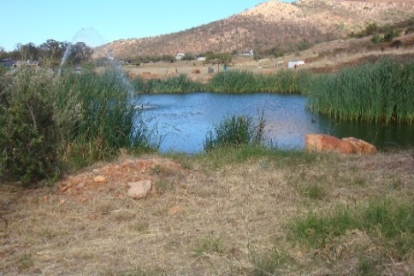
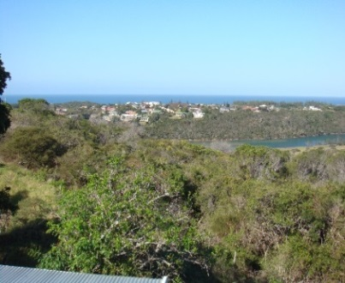
PATHS, PROCESSES & EXPERIENCES: Socio-Technical Interventions Within 3Ps Principles: People, Place, Planet
PLACE: Inspiring, Enchanting & Endearing | Recreational Parks & Green Infrastructure | Nature Within City: Water in Landscape | Nature Within City: Natural Landforms | Nature Within City: Indigenous Plants/Trees
 | Green Public Spaces and Recreation-Parks: Optimised Green Infrastructure/Services, Mitigates Urban Heat Island, Enhances Human-Interaction with Nature, Deepens Place-Attachment
PLANET: Rejuvenation & Restoration | Roof-Top Pv & Solar Water Heating | On-site Water-Treatment/Recycling | Central Sewage: Biogas-to-Electricity | Construction-Waste Recycle
 | Renewable Resources & Resource-Recovery: Reuse/Recycle

Slide 6
PATHS, PROCESSES & EXPERIENCES: ENERGY PERSPECTIVES
SUSTAINABLE/ENERGY EFFICIENT CITIES
DEFINITION: City which equitably support/facilitate the minimal/zero-carbon lifestyle-goals of its residents (human and organizations)
INDUSTRIAL SCALE
(Industrial efficiency and ecology)
CITY AND SETTLEMENT SCALE
BUILDING SCALE: (Commercial and Residential)
TRANSPORT
(commuting, distribution)
URBAN SERVICES
(energy, water, sewage, waste)
OPERATIONAL
ENERGY (Direct use)
EMBODIED ENERGY (INDIRECT: production process)
URBAN FORM
RENEWABLE/CLEANER ENERGY SOURCES
ENERGY EFFICIENCY (Micro-climate, comfort, orientation, insulation, thermal mass, ventilation, etc)
LONG-LIFE AND RE-USE OF BUILDINGS
MASS TRANSIT
REDUCE, RE-USE, RECYCLE
CLEANER FUELS
(hydrogen, bio-fuels)
REUSED MATERIALS AND COMPONENTS
LOCALISE ACCESS AND DISPOSAL
LOW-IMPACT MATERIALS
LOCALISE ECONOMY Mixed-use, Urban/organic Agriculture, Local processing, Pedestrian-friendly, Smart/Tele-commute)
RENEWABLE ENERGY (solar water heating, PVs, solar cooking, bio-fuels, etc)
HIGH-IMPACT BUT RECYCLABLE MATERIALS
TECHNOLOGIES, MARKETS/BEHAVIOUR, POLICY-INSTRUMENTS, INSTITUTIONAL STRUCTURES

Slide 7
PATHS, PROCESSES & EXPERIENCES: Building-Scale
Orientation, Envelope-Attributes
Footprint/Floor-Area Ratio
Roof/Floor-Area Ratio
Internal Layout/Materials
Latitude/Altitude
Design/Spec-Attributes
Sedentary/Daytime
Weather/Climate
Geographical/Natural-Attributes
Sedentary/Night-time
Lighting + Visual Comfort
Sedentary
Soil/Geo-Condition
Sedentary/24/7
NET-ZERO ENERGY BUILDING
User, Occupation + Time-of-Use
Site-Attributes + Micro-Climates
Thermal Comfort
Appliances + Plugloads
Active/ Daytime
Hard/Soft Surfaces
Building+ Vegetation
Integrated Equipment
Active
Active/ Night-time
Constructed Modifications
Soil/Geo-Condition
Active/ 24/7
Energy Input Services
Onsite
Offsite
100% Onsite
Partially Onsite
Partially/ Micro-Grid
100% Offsite National-Grid

Slide 8
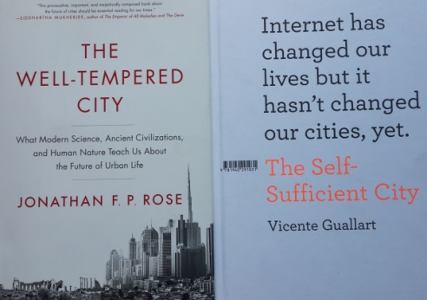
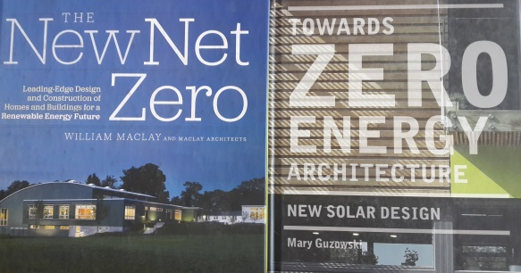
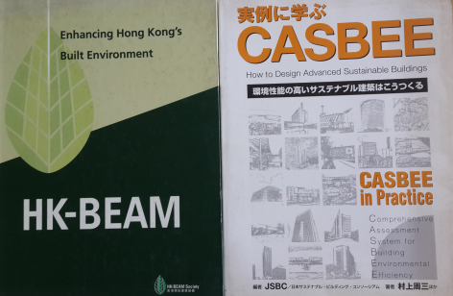
SUSTAINABLE BUILT ENVIRONMENT –
Sample of Aspirations & Transitioning Tools
Sustainable City Transitioning Guides | Green Building Rating Tools & NET-Zero & Net-Plus/Positive Energy Buildings Guides
Practice of Green Building Rating Tools now Close to a Generation but Still Struggling to Gain Traction. Nowhere Near Critical Mass Stage as Guided by Diffusion of Innovation Theory. Situation is Even Worse for Sustainable Cities Where Innovations Such as BRT Started as far Back as the 1960s in Curitiba

Slide 9
SAMPLE COLLABORATIONS & PARTNERSHIPS AT WITS
Scale/Theme | Trans-Disciplinary Platforms/Projects | Private-Sector Partners | Public-Sector Partners | Academic & Civil-Society Partners
Building Scale: Awards, Curriculum and | Promoting Renewable Energy Africa (PREA) 2006 – 2009 LafargeHolcim Awards for Sustainable Construction – 2004 – Ongoing Energy & Climate Change Strategy for Public Sector Buildings (DoE, 2014 – 2015) SAIA-AfriSam Awards Green-City Start-up Awards | Lafarge Holcim, Switzerland AfriSam South Africa BASF – South Africa | Department of Energy (DOE) Department of Public Works (DPW) CIDB City of Johannesburg | South African Cities Network (SACN) South African Institute of Architects CSIR University of Johannesburg
Urban/ Settlement Scale | Designing, Implementing and Measuring Sustainable Urban Development (DIMSUD 2002 – 2004) City-of-Johannesburg Sustainable Housing Policy (2000 – 2004) Green-City Start-up Awards |  | Department of Human Settlements City of Johannesburg Several Local Authorities (Africa, Europe, Latin America) | South African Cities Network (SACN) Sustainable Energy Africa (SEA) Several Universities (Africa, Europe, Latin America)
Policy/ Frameworks and Institutional Structuring | Climate Leadership for Sustainable Energy Transitions - 4-Cycles with GIZ and Wits (2010 – 2014). Green Building Rating Tools | Leadership Programme Participants from Public, Private Sector and Civil Society | Leadership Programme Participants from Public, Private Sector and Civil Society | GIZ Green Building Council of South Africa (GBCSA) Leadership Programme Participants from Public, Private Sector and Civil Society
Markets, Behaviour Change & Transitioning | Botswana Dialogue with the Dalai Lama on Botho/Ubuntu for Human Flourishing (in Collaboration with Mind & Life USA) (2017) |  | Government of Botswana | Mind & Life USA University of Botswana

Slide 10
SAMPLE COLLABORATIONS & PARTNERSHIPS: CURRICULUM OUTCOME
180-Credits, Multi-Disciplinary Programme (Master of Architecture in the field of Sustainable & Energy Efficient Cities – MArch(SEEC))
90-Credits Course-work + Examination, 90-Credits Mini-Dissertation (Research Report)
1-Year Full-Time, 2-Year Part-Time
Curriculum Needs Feed into Research Agenda under Other Programmes
50:50
Masters
Studies
Masters-Research/ Studies
180-Credits, 100% Research –Study:
Key Research Insights Factored Back into 50:50 Masters Programme
2-Year Full-Time, 3-Year Part-Time
PhD-Research/Studies
100% Research-Study - Key Research Insights Factored Back into 50:50 Masters Programme
3-Year Full-Time, 4-Year Part-Time
Trans-Disciplinary Collaborative Initiatives
Sensitively Prioritised Ongoing Initiatives of Varying Scale/Duration
Key Insights Factored into Curriculum for 50:50 Masters Programme
Partnership Needs Feed into Research Agenda under Other Programmes
Contextual Drivers and Sensing into Deeper Subconscious Processes

Slide 11

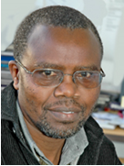
THANK YOU
Contacts
Prof Daniel Irurah
Associate Professor: Sustainable Architecture & Cities
CONVENOR: Multi-Disciplinary Masters Programme:
Masters in Architecture (Sustainable & Energy Efficient Cities – MArch(SEEC))
Email: daniel.irurah@wits.ac.za

