Slide 1


A SUB-ASSOCIATION OF THE SOUTHERN AFRICAN INSTITUE OF STEEL CONSTRUCTION

Slide 2
CHANGES EFFECTED IN SANS 10400 SERIES
PLETTENBERG BAY: 2019
DENNIS WHITE NOVEMBER 2019

Slide 3
AMENDMENTS TO SANS 10400-A
FORMS 1 TO 4 UPDATED TO BE MORE EXPLICIT AND USER FRIENDLY
FORM 1
SCHEDULES A & B REPLACED BY SECTION 3
REGULATIONS B, C PLUS G to Q: (BASICALLY SAME BUT REVISED LAYOUT)

Slide 4
3.1 REGULATION A: GENERAL REQUIREMENTS (NEW INTRODUCTION)
3.1.1 Have you read and is your application in compliance with Regulation A
Yes No
3.1.2 Is this an addition/extension that is going to be structurally supported by the existing building in terms of regulation A1(3) Yes No
3.1.3 If yes to 3.1.2, please provide name of competent person who will be appointed to judge that the existing building will be capable of carrying any additional structural load and, in writing, will so inform the local authority at submission of the building application
Name of Competent Person (Structures)……………………
ECSA Registration Number……………………………………..
3.1.4 if this submission was the subject of a preliminary plans and enquiries submission in terms of Regulation A3, a copy of the written comments received from the local Authority must be attached to the application
4

Slide 5
3.4 REGULATION D: PUBLIC SAFETY
3.4.1 Is compliance with this regulation applicable Yes No
3.4.2 Do changes in level comply with the requirements of sans 10400-D
Not applicable Yes No
3.4.3 are there any barriers (balustrades etc.) To be provided Yes No
3.4.4 If yes to 3.4.3 please provide name of competent person who will be appointed to assess the structural integrity in terms of regulation B
Name of competent person (structures)………………………………..
Esca registration number………………………………………………….
3.4.5 do ramps and driveways comply with the requirements of sans 10400-D
Not applicable Yes No
3.4.6 does the access to swimming pools comply with the requirements of sans 10400-D
Not applicable Yes No

Slide 6
TH
REGULATION E: DEMOLITION WORK (NEW INTRODUCTION)
REGULATION F: SITE OPERATIONS (CONSIDERABLY EXPANDED TO INCLUDE SUCH ITEMS AS PROTECTION OF PUBLIC, PREPARATION OF SITE, SOIL POISONING, UNREASONABLE LEVELS OF NOISE, DUST, ETC.)
6

Slide 7
THHE
FORMS 2 & 3
CONTENT BASICALLY THE SAME (JUST REFORMATTED)
FORM 4
CONTENT THE SAME (JUST REFORMATTED)

Slide 8
TH
AMENDMENTS TO SANS 10400-B: STRUCTURAL DESIGN
NORMATIVE REFERENCES:
SANS 517 LIGHT WEIGHT STEEL FRAME BUILDINGS(NEW)
DEFINITIONS
BARRIER: ALL WALLS, CURTAIN WALLS, PARTITIONS, BALUSTRADES AND ALL GLAZED AREAS, WHETHER PERMANENT OR TEMPORARY, INTENDED TO ACT AS A BARRIER TO PREVENT PEOPLE FROM FALLING (NEW)
REQUIREMENTS
GENERAL: CLAUSE PERTAINING TO LIGHT WEIGHT STEEL FRAME BUILDINGS (SANS 517) (NEW)

Slide 9
4.2 RATIONAL DESIGN AND RATIONAL ASSESSMENT
4.2.1.1 BARRIERS TO HAVE A DESIGN WORKING LIFE OF 30 YEARS (NEW)
4.2.1.3 WIND LOADING: AMENDED TO ALIGN WITH REVISED TERMINOLOGY IN SANS 10160-3
4.2.1.5 SANS 517 AND SANS 10082 ADDED TO LIST OF DESIGN STANDARDS
TABLE 1: TITLE EXPANDED TO INCLUDE DOMESTIC RESIDENCES
ROOF ELEMENTS: CANOPIES INCLUDED UNDER LOCAL EFFECT
9

Slide 10
TABLE 4: (NEW ADDITION) REPRESENTATIVE ACTIONS OF IMPACT FORCES APPLIED TO BARRIERS
TABLE 5: CLASSIFICATION OF DAMAGE IN MASONRY WALLS AMENDED TO INCLUDE BARRIERS
ANNEX B: PERFORMANCE TESTS PERTAINING TO STRUCTURAL SAFETY, SERVICEABILITY AND DURABILITY
(NEW) CLAUSE B.2.8 IMPACT TEST FOR GLASS WALLS, PARTITIONS AND BARRIERS TO COMPLY WITH SANS 1263-1
10

Slide 11
TH
AMENDMENTS TO SANS 10400-D: PUBLIC SAFETY
2 NORMATIVE REFERENCES (DELETED)
2 DEFINITIONS
2.1 ARRESTING DEVICE (NEW)
2.2 BARRIER: AMENDED TO ALIGN WITH SANS 10400-B
2.5 HANDRAIL (NEW)
2.7 RIMLESS POOL (NEW)
11

Slide 12
TH
3 REQUIREMENTS
3.1 GENERAL: (EXPANDED TO INCLUDE CRITERIA PERTAINING TO BARRIERS)
3.1.2 BARRIERS SHALL BE DESIGNED AND COATED TO RESIST THE CORROSIVITY OF THE ENVIRONMENT IN WHICH THEY OPERATE
3.1.3 BARRIERS SHALL BE INSPECTED AT REGULAR INTERVALS. ANY ELEMENT, CONNECTION OR ANCHORAGE SHOWING ANY POSSIBLE LOSS OF EFFECTIVENESS OR STRUCTURAL INTEGRITY SHALL BE RESTORED OR REPLACED
3.1.4 BARRIERS SHALL NOT COMPRISE OF COMPONENTS WITH SHARP PROJECTIONS OR EDGES THAT MAY CAUSE INJURY OR SNAG CLOTHING
12

Slide 13
3.1.5 BARRIERS IN PUBLIC AREAS AND OPEN SPACES ARE TO BE CLEARLY VISIBLE FROM A DISTANCE OF 7.5m SO AS TO AVOID INJURY TO PERSONS RUNNING INTO THEM. THE MINIMUM DIMENSION CLEARLY VISIBLE FROM 7.5m IS 20mm. ELEMENT THINNER THAN 20mm TO HAVE SIGNS ATTACHED, AT REGULAR INTERVALS, SO AS TO BE VISIBLE FROM 7.5m
3.1.6 FLEXIBLE ELEMENTS E.G. CABLES AND ROPES SHALL BE MAINTAINED UNDER TENSION SO AS NOT TO IMPINGE ON THE SPACING REQUIREMENTS OF ELEMENTS
113

Slide 14
TH
3.2 CHANGE OF LEVEL
(ALL REFERENCES TO BALUSTRADES, PARAPETS AND WALLS CHANGED TO BARRIER)
3.2.2 EXPANDED TO INCLUDE WALKWAYS AND MEASUREMENT OF CHANGE IN LEVEL REDUCED TO 600MM
3.2.4 OCCUPANCY CLASSIFICATIONS FOR BALUSTRADE AND HANDRAIL TYPE BARRIERS CHANGED
3.3 RAMPS AND DRIVEWAYS
CLAUSES b) + c) (REWRITTEN TO ALIGN WITH SANS10400-S)
14

Slide 15
TH
3.4 SWIMMING POOLS AND SWIMMING BATHS
3.4.1 NOW APPLIES TO OCCUPANCY CLASS H4 ONLY
3.4.4 REWRITTEN AND EXCLUDES REFERENCE TO SANS 1390 (POOL FENCES)
3.4.5 (NEW) DETAILS REQUIREMENTS FOR FITTINGS ON GATES
3.4.6 (NEW) POSITION OF HINGES AND LOCKING DEVICE
3.4.7 (NEW) CHANGE OF LEVEL ADJACENT TO RIMLESS POOLS
15

Slide 16
TH
AMENDMENTS TO SANS 10400-L: ROOFS
2 REFERENCES (DIVIDED INTO TWO CATEGORIES)
2.1 NORMATIVE REFERENCES:
SANS 10400-XA & SANS 517 LT/WEIGHT STEEL FRAME BUILDINGS (NEW)
2.2 INFORMATIVE REFERENCES: (NEW)
ESSENTIALLY COMPRISES SANS STANDARDS FOR MATERIALS USED TO FABRICATE ROOFING ELEMENTS AND COMPONENTS PLUS ISO 9223 & ISO 9224 RELATING TO THE CORROSIVITY OF METALS
16

Slide 17
TH
3 DEFINITIONS
3.1 BMT: BASE METAL THICKNESS OF COATED METAL PRODUCTS (NEW)
3.12 COMBUSTIBLE: (REWRITTEN)
3.14 COMPETENT PERSON: (MODIFIED TO INCORPORATE VARIOUS DISCIPLINES)
3.20 HARDWOOD: (NEW)
3.22 LIGHT GAUGE STRUCTURE: (NEW)
3.33 ROOFLIGHT: (NEW)
17

Slide 18
TH
4 REQUIREMENTS
4.1 GENERAL: (REWRITTEN)
4.2 ROOF COVERINGS AND WATERPROOFING SYSTEMS
4.2.1.1.a): (DIFFERENTIATION BETWEEN CATEGORY 1 AND OTHER BUILDINGS REMOVED)
4.2.1.1c) (NOTES PERTAINING TO METALLIC COATINGS REMOVED)
4.2.1.2 (DESIGN WORKINGLIFE PERIOD CHANGED FROM 10 TO 15 YEARS TO ALIGN WITH 10400-B)
4.2.1.4 (NEW CLAUSE PERTAINING TO BI-METAL CORROSION)
18

Slide 19
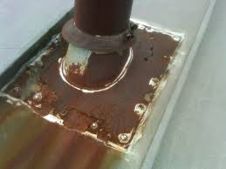
TH
ANODE
CATHODE
19

Slide 20
TH
4.2.2 METAL ROOF CLADDING AND ACCESSORIES (NEW SECTION)
4.2.2.2.1 BASE METAL THICKNESS: INCLUDES TABLES FOR DIFFERENT METAL COATINGS, GRADES OF STEEL AND PROFILES
4.2.2.3 DURABILITY REQUIREMENTS: MATCHES COATINGS AND METALS TO ENVIRONMENTAL CORROSIVITY CATEGORIES AS PER ISO 9223+9224
4.2.2.4 MARKING REQUIREMENTS: ALL COIL USED FOR THE MANUFACTURE OF METAL CLADDING SHALL CARRY AN INDELIBLE DISTINCTIVE MARK AT REGULAR INTERVALS CONTAINING THE NAME OF MANUFACTURER, BMT, WEIGHT OF METALLIC COATING (IF APPLICABLE) AND DETAILS OF ANY OTHER COATING APPLIED TO THE CLADDING. IF COIL IS UNMARKED CERTIFICATE OF COMPLIANCE REQUIRED FROM AN ACCREDITED LAB

Slide 21
Brand name
Width (m)
Galvanized coating & thickness
CHROMADEK TCT=0.58 W=0.925 Z200 ISQ 300 KY47331 14/02/25 08:59
Total coated thickness (mm)
Quality of steel core (MPa)
55% Aluminium/steel coating & thickness
Producer mill
ZINCZLUME ® steel AZ150 G300 TCT 0.53 made by BlueScope 15: 18 02 : SEP: 2017 17
Brand name
Quality of steel core (MPa)
Producer mill
Brand name
Safal Steel ZINCAL 925x0.47 G550 AZ150 6700-1-1
Width & thickness TCT (mm)

Slide 22
TH
CORROSIVITY CATEGORY | ISO CLASSIFICATION
C1 | DESSERT
C2 | RURAL/SEMI-DESSERT
C3 | URBAN & INLAND INDUSTRIAL
C4 | MEDIUM-SEVERE MARINE
C5 | MARINE INDUSTRIAL
C5X | SEVERE MARINE
21

Slide 23
TH
4.2.2.5 FASTENERS:
DETAILS WHICH TYPES OF FASTENERS MAY BE USED FOR BOTH PRIMARY (ATTACH CLADDING TO SUPPORTING STRUCTURE) AND SECONDARY FIXINGS (ATTACH FLASHINGS AND OTHER ANCILLARY ITEMS TO CLADDING)PLUS REQUIREMENTS FOR WASHERS.
4.2.2.6 EARTHING:
ALL METAL ROOF CLADDING SHALL BE EARTHED IN ACCORDANCE WITH SANS 10142-1 BY A COMPETENT PERSON
22

Slide 24
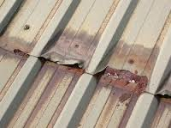
TH
4.2.3 ROOF COVERINGS IN PITCHED ROOFS (REWRITTEN)
4.2.3.1 ALL END LAPS TO BE MINIMUM 250mm AND SEALED
4.2.3.2 ROOF COVERINGS SHALL BE SPECIFIED TO MATCH ENVIRONMENT
4.2.3.5 THATCHING SHALL COMPLY WITH SANS 10407
TABLE 8: MINIMUM THICKNESS OF THATCH PER CLIMATE ZONE
224

Slide 25
TH
4.2.4 ROOFLIGHTS (REWRITTEN)
4.2.4.1 IN-PLANE ROOFLIGHTS: NOT WIDER THAN A SINGLE SHEET WIDTH & FIXED OVER ADJACENT METAL CLADDING. MAX PURLIN CENTRES AND FIXING DETAILS
4.2.4.2 OUT-OF-PLANE ROOFLIGHTS: SHALL BE INSTALLED IN A MANNER THAT DOES NOT INTERFERE WITH THE STRUCTURAL INTEGRITY OF THE ROOF SUPPORT STRUCTURE
24

Slide 26

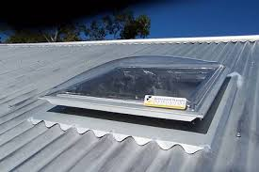
TH
IN PLANE
OUT OF PLANE
25

Slide 27
TH
4.3 WATERPROOFING TO BALCONIES, TERRACES AND PARKING DECKS (NEW: REPLACES DRAINAGE AND WATERPROOFING OF FLAT ROOFS)
4.3.2 GUTTERS AND DOWNPIPES (REWRITTEN)
4.3.3 FLAT CONCRETE ROOFS (MINOR CHANGES)
26

Slide 28
TH
4.4 TIMBER ROOF CONSTRUCTION: CLAUSES AMENDED & CLAUSES ADDED
DETAILS FOR SUPPORTING INTERNAL GEYSERS
DETAILS FOR ATTACHMENT OF SOLAR GEYSERS INCL. ON THATCH
DETAILS FOR POLE CONSTRUCTION
4.5 FIRE SAFETYREQUIREMENTS: (NEW)
27

Slide 29
TH
4 NEW ANNEXES ADDED
ANNEX A (INFORMATIVE)
PRINCIPLE WATERPROOFING DETAILS
ANNEX B (NORMATIVE)
STANDARD FLASHING DETAILS FOR METAL ROOFING
ANNEX C (INFORMATIVE)
STANDARD FLASHING DETAILS FOR CONCRETE TILES
ANNEX D (INFORMATIVE)
COMPATIBILITY OF METALS AND METAL COATINGS
28

Slide 30
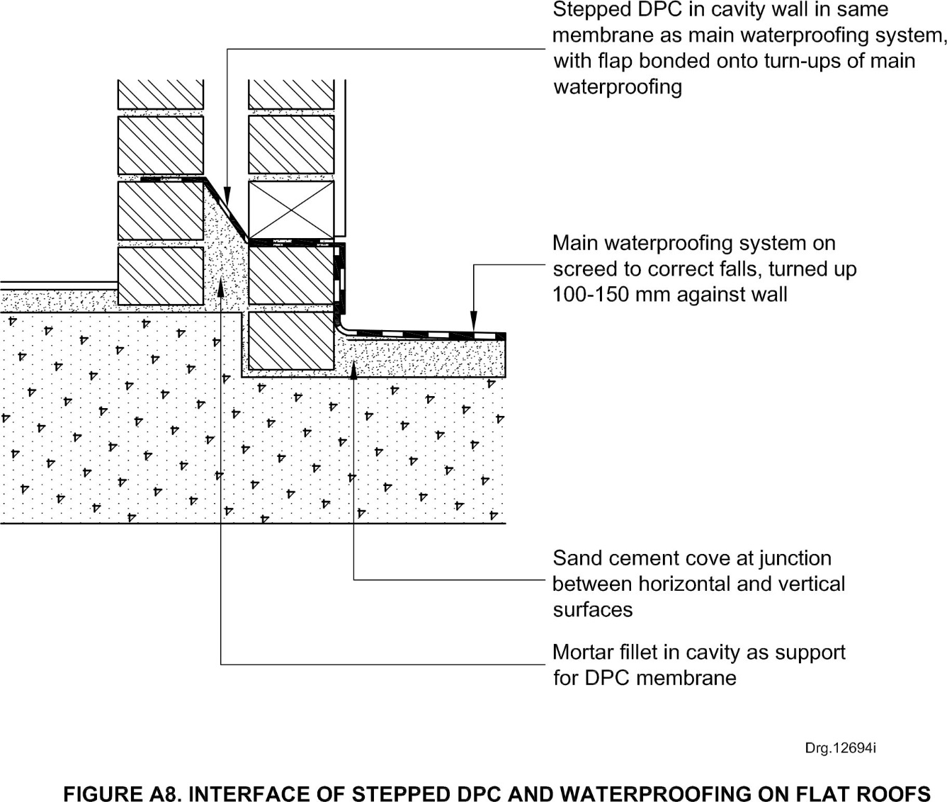
TH
29

Slide 31
TH
30° min
20 mm min
75 mm min
15 mm min return
30° min
5 mm
SIDEWALL
Bead of sealant
Std lip
10mm
30°
100 mm
min
Serrated metal
closure
200 mm
min
lip
Roof cladding
20 mm clear
Vertical cladding
APEX
COUNTER FLASH
310

Slide 32
TH
AMENDMENTS TO
SANS 10400 X: ENVIRONMENTAL SUSTAINABILITY
SANS 10400 XA: ENERGY USAGE IN BUILDINGS
EFFECTIVELY A TOTAL REWRITE AND INCORPORATION OF SANS 204
321

Slide 33
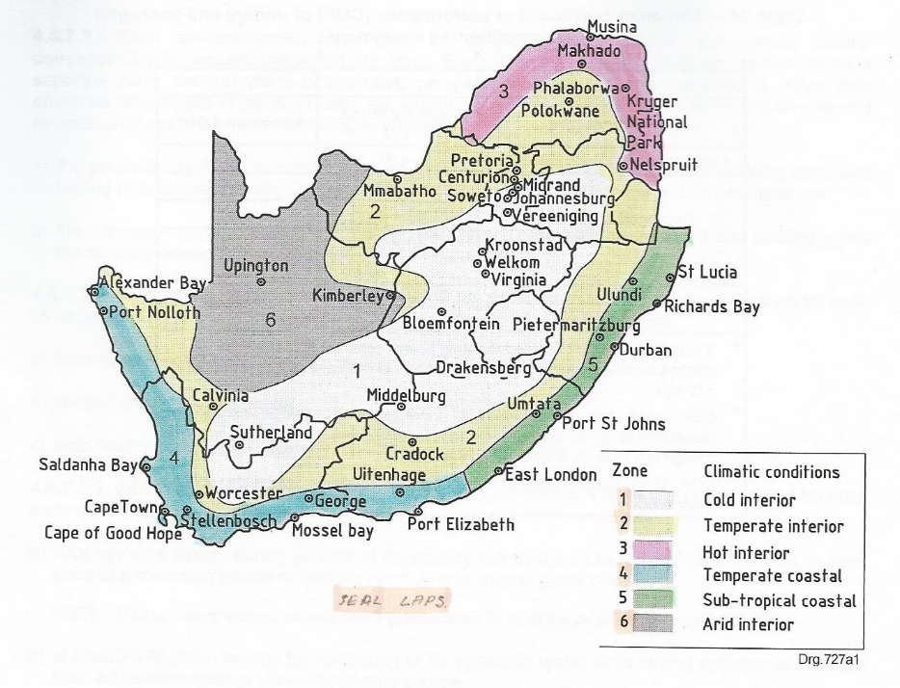
NEW ENERGY ZONE MAP
7 CLIMATE ZONES+HUMIDITY LINE
6 CLIMATE ZONES
332

Slide 34
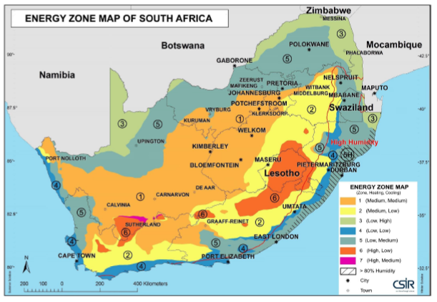
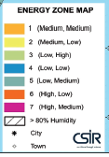
Heating: Cooling
1 Medium: Medium
2 Medium: Low
3 Low: High
4 Low: Low
5 Low: Medium
6 High: Low
7 High: Medium
> 80% Humidity
343

Slide 35
Table 1- List of Cities and Towns by Energy Zones
4
4 Low: low
354

Slide 36
TH
5 BUILDING ENVELOPE
5.1 SITE ORIENTATION:
5.1.1BUILDINGS SHOULD BE ORIENTATED TO FACE BETWEEN NORTH-EAST AND NORTH-WEST TO FACILITATE SHADING, EXCEPT IN ZONE 5H
5.1.2 IN ZONE 5H BUILDINGS SHOULD BE ORIENTATED TO MAKE USE OF THE PREVAILING WIND TO COOL THE BUILDING THROUGH NATURAL VENTILATION
5.2 SHADING: AGAINST SUMMER SOLAR RADIATION
5.2.1 DEVICE MUST BE PERMANENT
5.2.2 GUIDELINES ON MINIMUM FUNCTIONAL REQUIREMENTS OF SHADING DEVICE
365

Slide 37
TH
5.3 FENESTRATION:
INCLUDES TABLES OF WHOLE GLAZING ELEMENT PERFORMANCE VALUES PLUS THERMAL PERFORMANCE OF ROOFLIGHT COMPONENTS
5.4 FLOORS:
INSULATION REQUIREMENTS FOR UNDERFLOOR HEATING AND SUSPENDED FLOORS
5.5 EXTERNAL WALLS:
TABLE OF MINIMUM R-VALUES FOR EACH ENERGY ZONE
5.6 ROOF ASSEMBLY: NO COMPRESSION OF BLANKET INSULATION
376

Slide 38
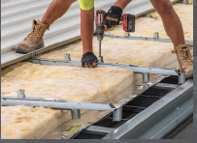
TH
EXAMPLE OF SPACER SYSTEM
387

Slide 39
TH
6 SERVICES
6.1 HOT WATER SUPPLY:
LISTS TYPES OF NON-ELECTRICAL WATER HEATERS
PERFORMANCE AND INSTALLATION REQUIREMENTS
TABLE OF HOT WATER CONSUMPTION, USAGE AND STORAGE FOR EACH OCCUPANCY CATEGORY
6.2 LIGHTING:
TABLE OF DESIGN UTILIZATION RATES
398

Slide 40
TH
ANNEX A: SA ENERGY TRAJECTORY (INFORMATIVE)
PROVIDES AN OUTLINE OF THE ENERGY TRAJECTORY CONTAINED IN THE DRAFT ENERGY EFFICIENCY STRATEGY
ANNEX B PERFORMANCE VALUES (INFORMATIVE)
PROVIDES PERFORMANCE GUIDELINES FOR DESIGNERS PERTAINING TO ENERGY USAGE
ANNEX C SOLAR REFLECTANCE (INFORMATIVE)
DEFINES TERMS ASSOCIATED WITH SOLAR RADIATION PLUS A TABLE OF THE SRI VALUES OF TYPICAL ROOFING MATERIALS
409

Slide 41
TH
ANNEX D: THE INSTALLATION OF INSULATION IN ROOF ASSEMBLIES (INFORMATIVE)
CONTAINS GUIDELINES AND GRAPHICS OF HOW TO INSTALL INSULATION
ANNEX E: WHOLE GLAZING ELEMENT PERFORMANCE (INFORMATIVE)
COMPRISES A TABLE OF PERFORMANCE FIGURES FOR DIFFERENT TYPES OF FRAMED GLASS
ANNEX F: SHADING DEVISES (INFORMATIVE)
GRAPHIC REPRESENTATION OF 12 SHADING DEVICES, BOTH FIXED AND MECHANICALLY OPERATED
40

Slide 42
QUESTIONS
41

