Slide 1
Fred van Zyl
22 November 2018
Water-related Sustainable Development Goals

Slide 2
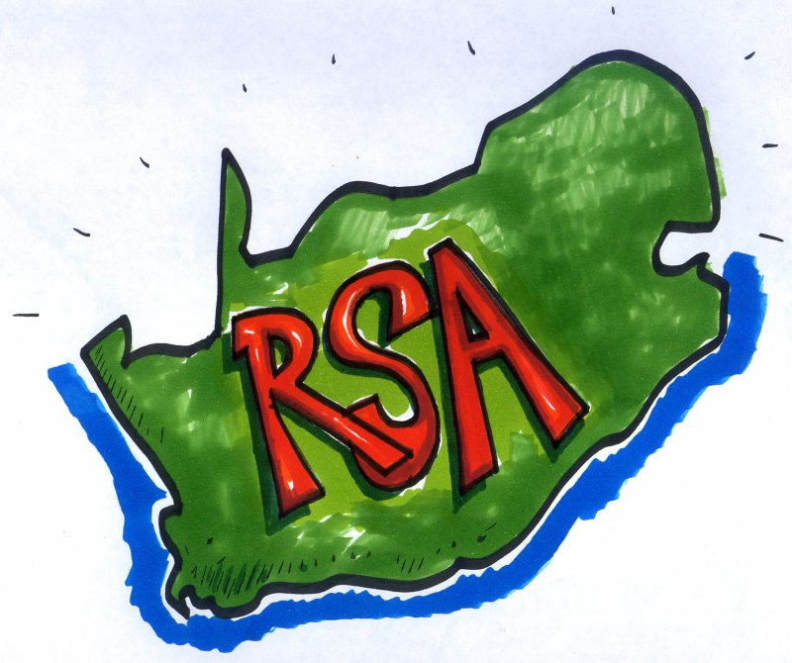
What is your role & commitment in addressing the water resource challenges ?

Slide 3
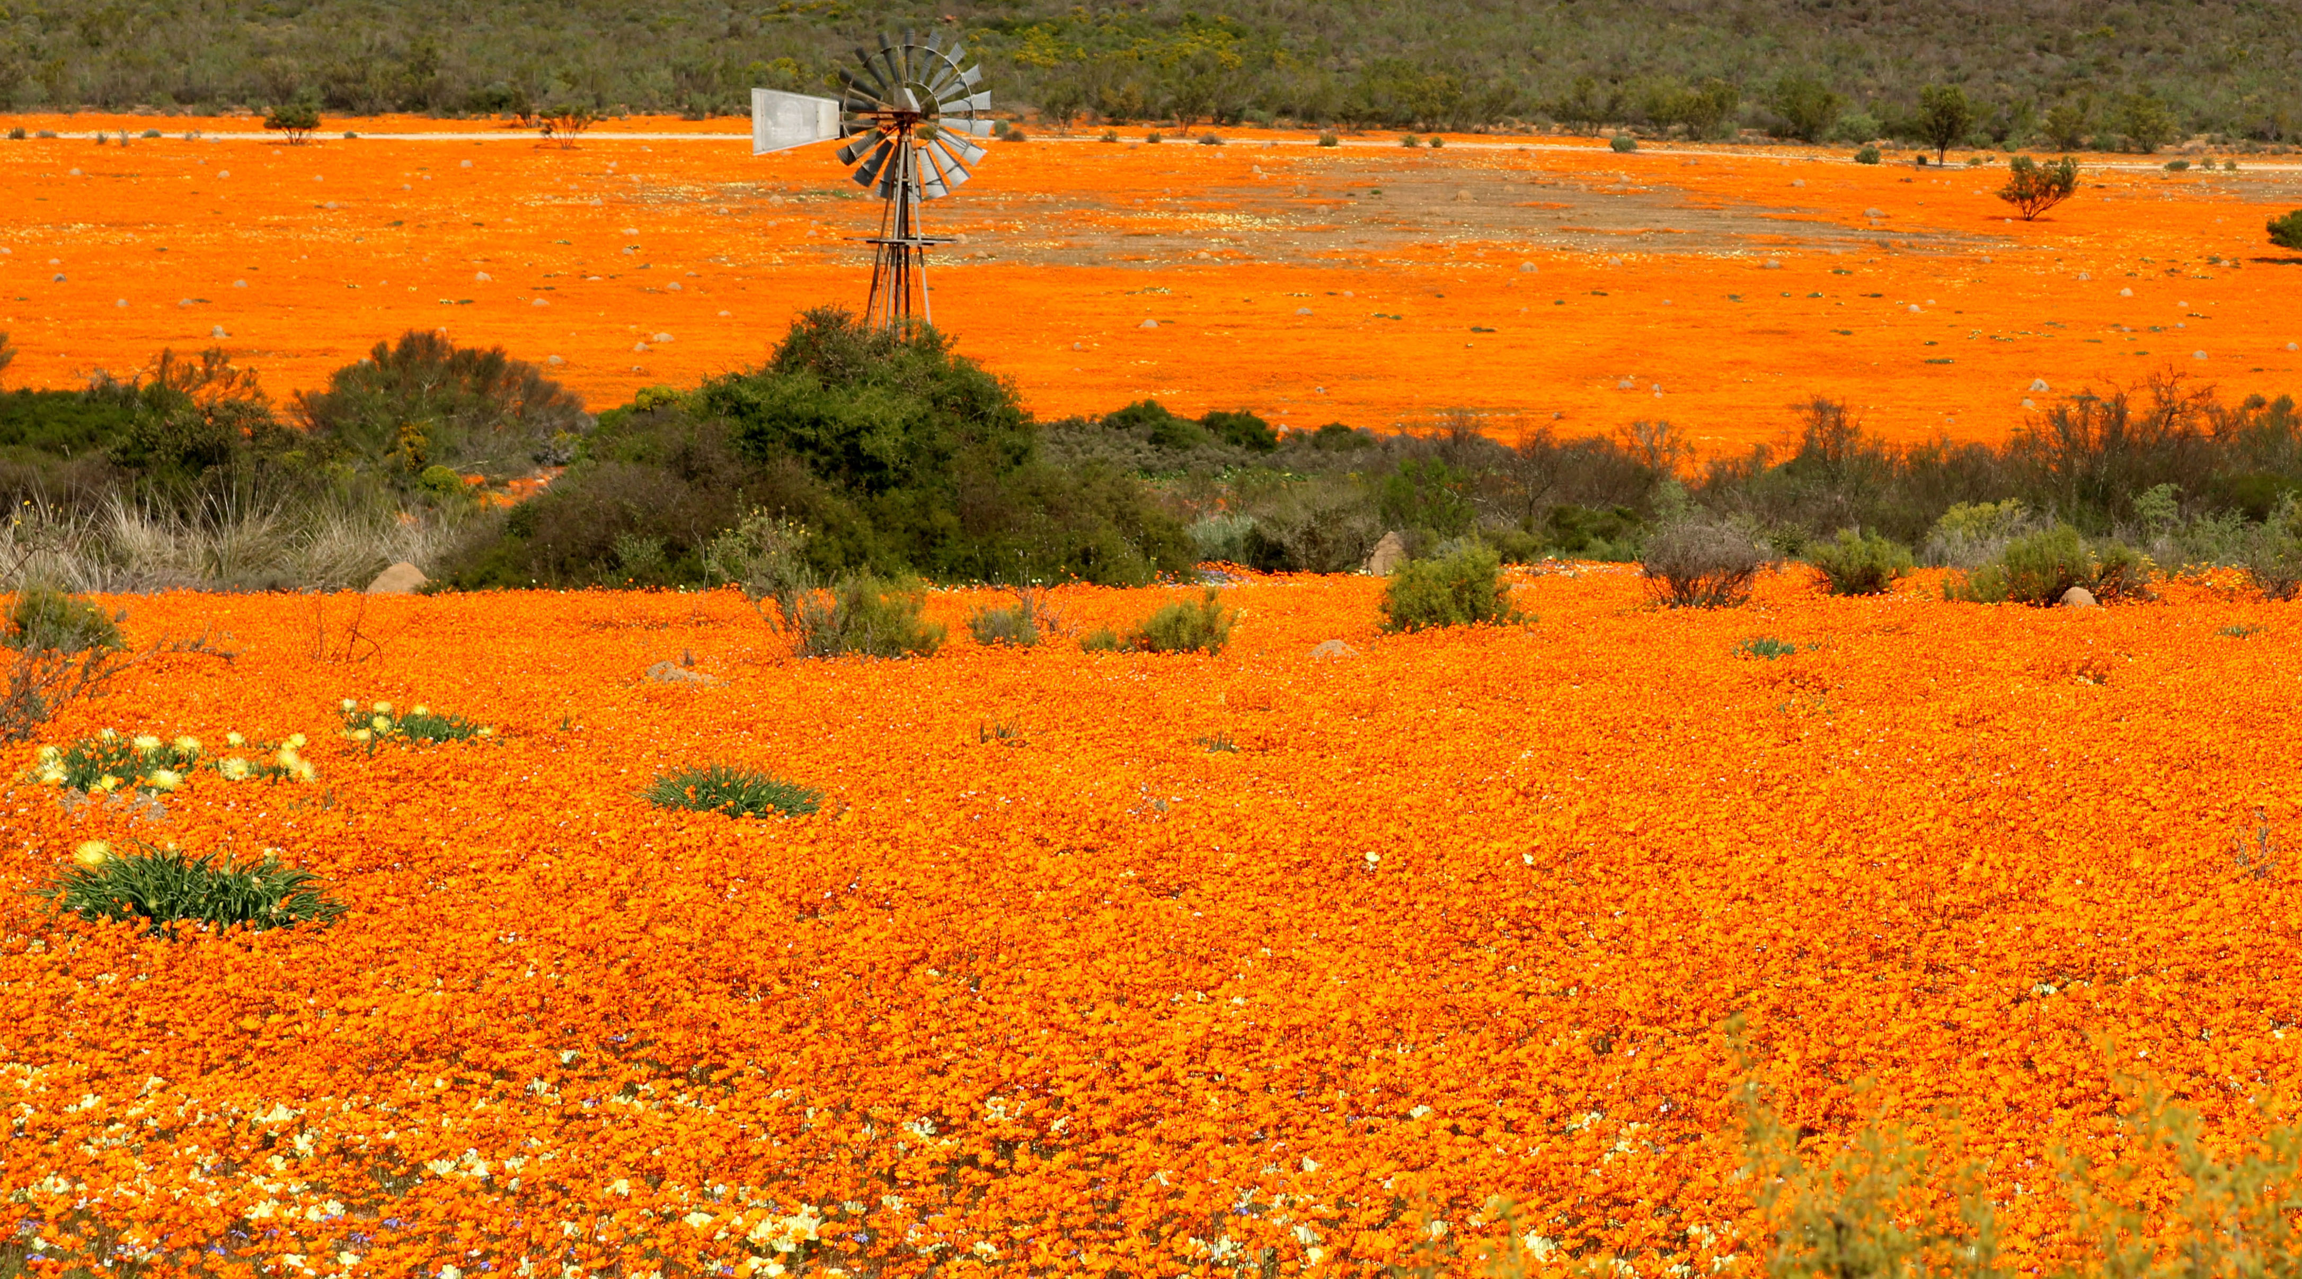

Slide 4
Help !!!
We have serious water problems and challenges !!!

Slide 5
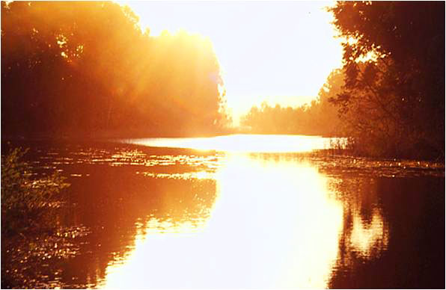
It is about managing a precious and strategic resource

Slide 6
Importance of Water ?
How do we value our water resources?
  “Water is Life”
  Impact of “no” water and restrictions?
  Social, economic and environmental value?
Contradiction:
  How do we respect, protect, waste, pollute, abuse and misuse water?
  Does it really have any value?
Do we understand and appreciate the water risks in South Africa?
Are we concerned?

Slide 7
We have to rethink the way we approach and manage the country's resources:
"The real magic of discovery lies not in seeking new landscapes but in having new eyes...”
Marcel Proust

Slide 8
It is not just about having “sight”,
It is about having “insight”!

Slide 9
1. The ultimate goal !
‘The care of human life and happiness and not their destruction
is the first and only legitimate object of every good Government.’
  Thomas Jefferson

Slide 10
Positioning Water
Water
Human
Social
Prosperity
All South
Africans
Financial
Soil
Economic
Material
Machines
Air
Environmental
Good Governance

Slide 11
Water Obligation: Focus on Outcome
(as per N ational WAter Act)
Water resources must be:
Basic human needs
Equitable access
protected
Redressing the past
used
Efficient, sustainable use
To support (achieve)
developed
Social & economic development
conserved
protecting aquatic ecosystems
managed
Prevent pollution & degradation
controlled
valued
Disasters, dam safety, international, growth

Slide 12
“The obligation”
We have to ensure that all people in South Africa have access to
sustainable, reliable, effective, safe and affordable water services !

Slide 13
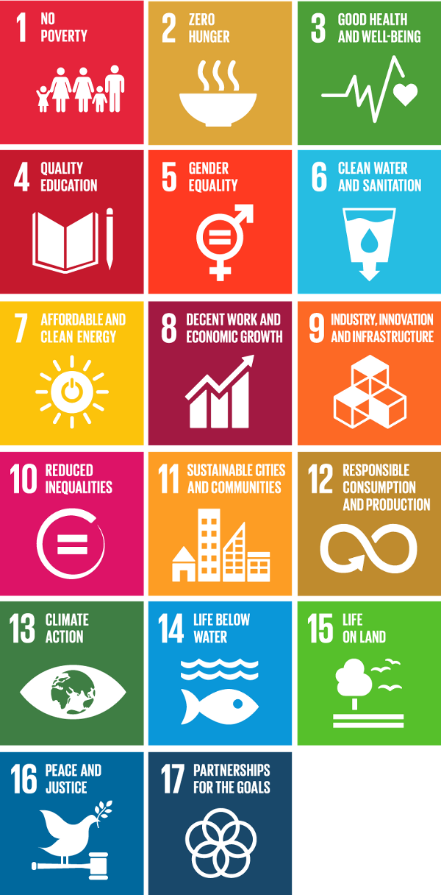
Sustainable development goals

Slide 14
SDG Goal 6 Focus areas
Water within growth and development
1
Effective Water resource management
2
3
Goals 1 - 17
Access to reliable water& sanitation services
social
Water security
Resource quality
economic
Ecosystems management
Disaster management
Climate change
environmental
Integrated Water Management

Slide 15
Need Successful outcome
Critical success factors
Obligation to perform
Commitment, ownership & drive
Accountability; Responsibility
Dedicated/focused action and performance
Sustained management

Slide 16
2. Getting to grips with our water situation
South Africa is a “fresh water” scarce country (30th driest country in the world)
High rainfall and runoff variability (unevenly distributed in space and time)
Need to support major social and economic development
Development is not aligned with water resource availability
South Africa is a naturally water stressed country, further challenged by the impact of supporting growth and development

Slide 17
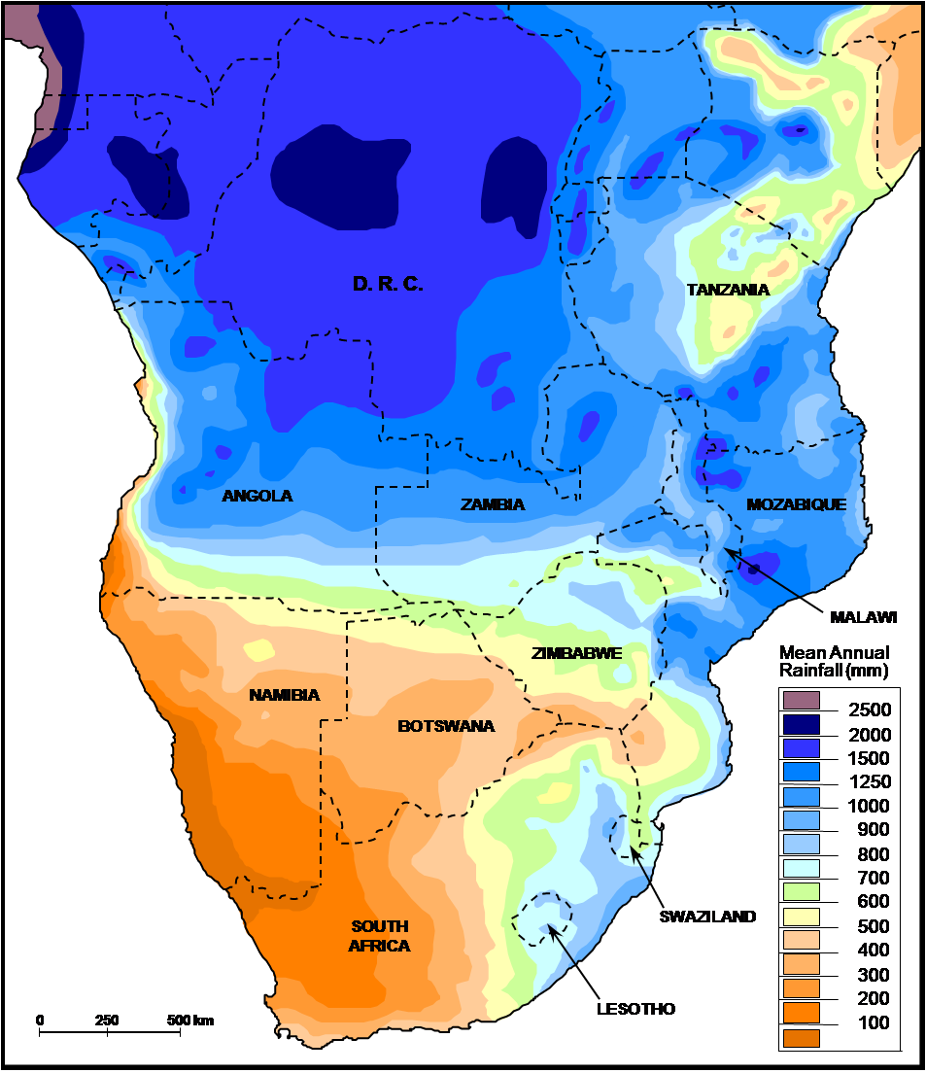
Southern Africa is a water scarce country
Regional context
Southern Africa is a water scarce country
Regional context
Notes:
South Africa is relatively dry compared to other SADC countries
The map depicts that:
Rainfall is relatively higher in the northern and eastern parts of Southern Africa (viz. DRC, Zambia and Mozambique)
The drier parts of the region include Namibia, Botswana and South Africa
Southern Africa only has 12.25% of the total water in Africa (i.e. highly arid region)
Dissolved salts from host rocks in some areas (e.g. Namaqualand in the N Cape) may also impact on the quality of water

Slide 18
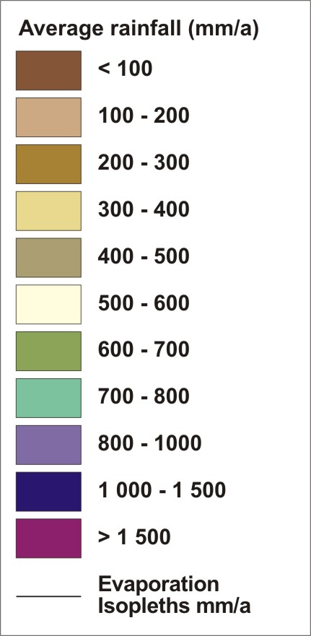
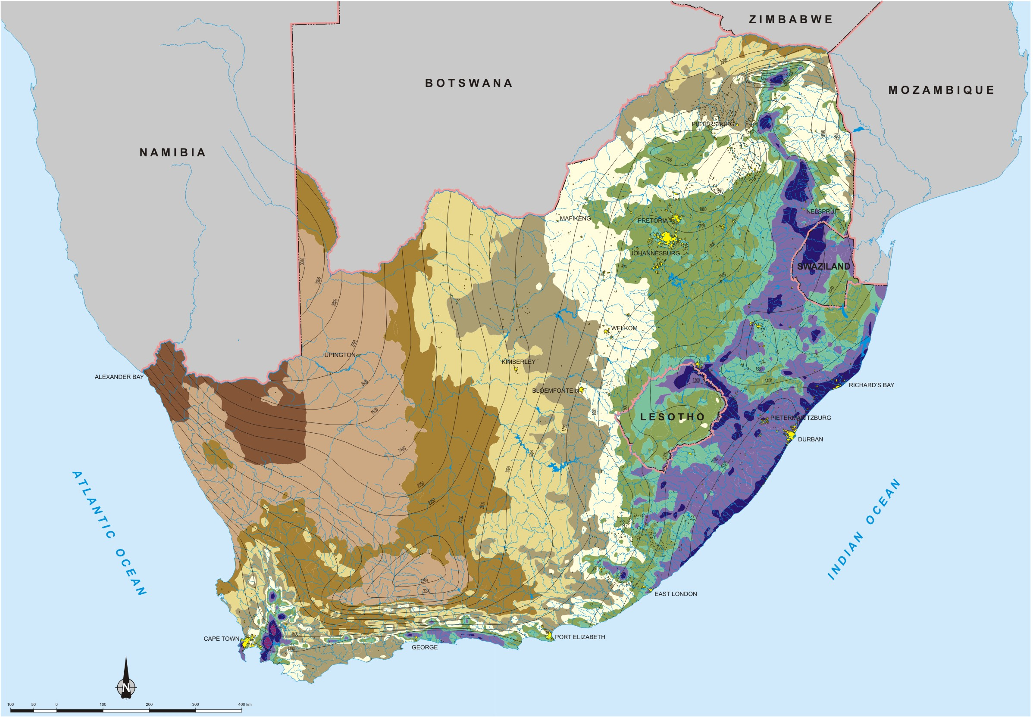
National Rainfall and Evaporation
Wet
Arid
Notes:
Semi-arid climate, highly variable, long droughts.
Uneven rainfall distribution, decreases from east to west.
Potential evaporation increases from east to west, in most parts much higher than rainfall.
World terms: water scarce, becoming water stressed.
Most water from surface resources.
No real large rivers in SA (Flow in Orange River only 10 % of that of Zambezi River where rivers discharge into the ocean).
Generally hard rock formations, little groundwater.
Groundwater main source in rural and dry areas (small quantities).

Slide 19
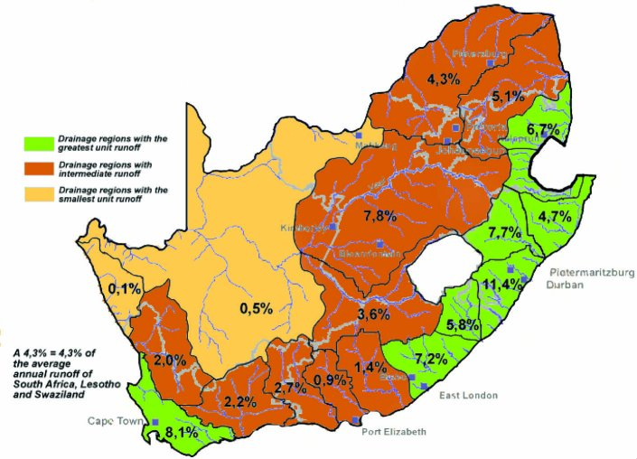
Annual surface runoff
Seasonal
Episodic
Perennial

Slide 20
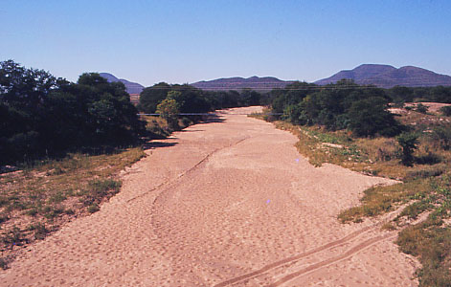
… Episodic.

Slide 21
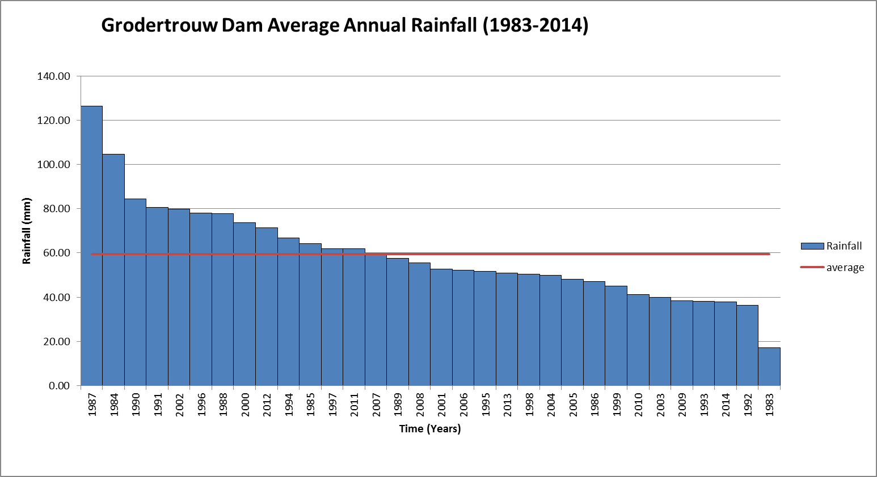
Drought is part of the Business!
60% of time below avg rainfall
2014 is 3rd worst drought in 30 years

Slide 22
VARIATIONS IN RIVER FLOW
66% of time below average
Long term average

Slide 23
The baseline situation
60 to 70% of the time we are in a “drought” situation!
Run-off highly variable spatially and in time
Limited base-flow
So ?????

Slide 24
So?
“Normal” in South Africa means to experience below average rainfall and run-off for 6 to 7 out of every 10 years
Some years just worse than the others
And floods

Slide 25
3. So, how have we survived thus far?

Slide 26
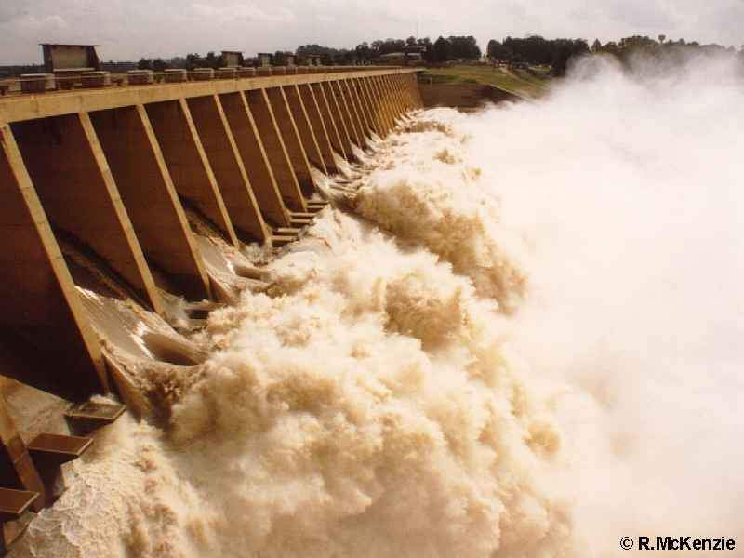
Major Infrastructure Development !
Integrated
Vaal River System
26

Slide 27
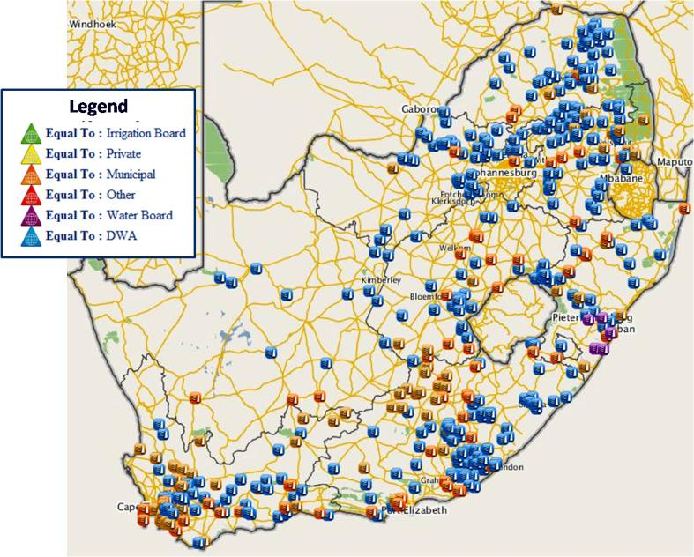
Extensive Water Resource Development
480 domestic water related dams more than 5700 dams
321 DWS owned
318 municipal owned
2828 water supply related (includes irrigation & excludes mines, floods etc.)
480 for domestic supply
Others (irrigation, waste, flood, pollution control)
major resource development
platform for multi-purpose use
extensive municipal assets
management implications

Slide 28
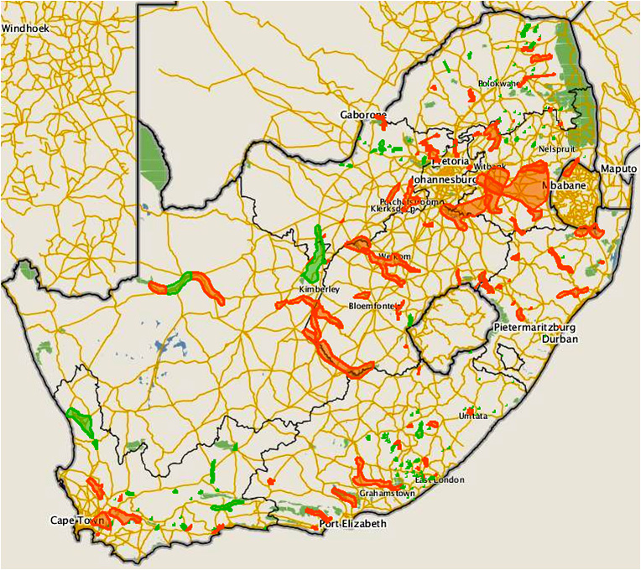
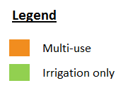
Major Water schemes
236 Water Resource schemes
Including transfer schemes

Slide 29
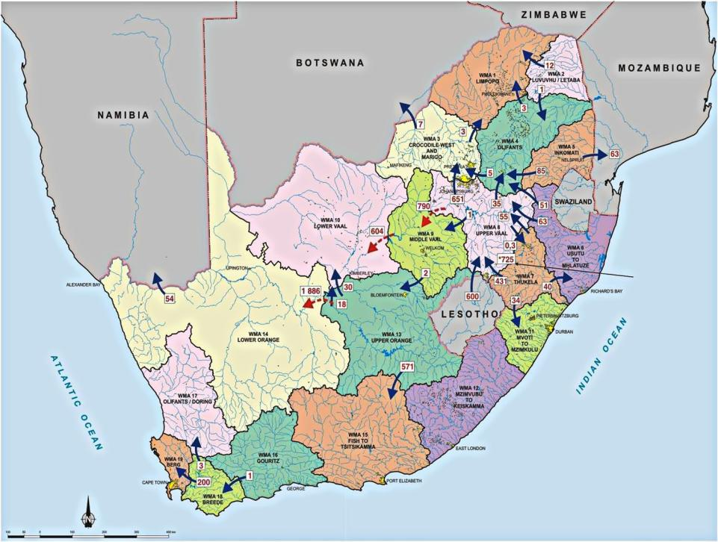

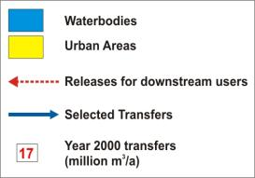
Water Management Areas and Main Water Transfers
Notes:
Country subdivided into 19 WMAs to better address local conditions and to facilitate improved management of resources.
Mention that more information will be given later in the day on Cathment Management Agencies, as managing authorities for WMAs.
WMAs designated by catchment boundaries, not following provincial boundaries.
By considering national averages only, important details and differences can often be masked. Therefore even WMAs divided into sub-areas as will later be shown.
Note transfers to overcome imbalances between geographic occurrence and requirements for water (some WMAs interlinked by river).
(More detail on imbalances in slides to follow.)
Mzimvubu to Keiskamma WMA is only one in country not linked through transfers to another WMA.
Advise audience that more detail available in Appendix D of NWRS and in WMA reports.

Slide 30
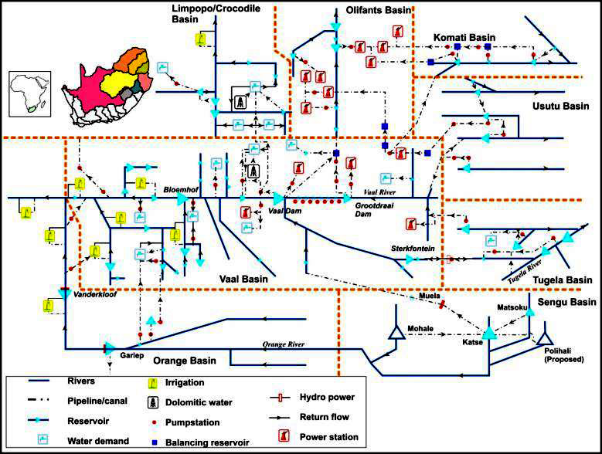
Complex Transfer Systems & Management

Slide 31
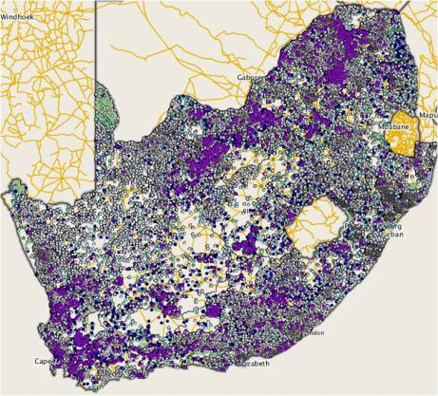
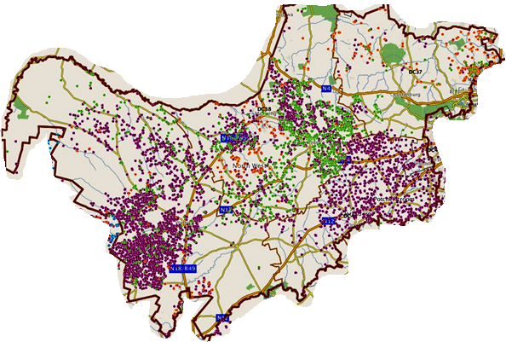
Extensive groundwater development
Existing Boreholes
Comprehensive
data base of:
  GW potential, borehole
  locations & yields
NW province

Slide 32
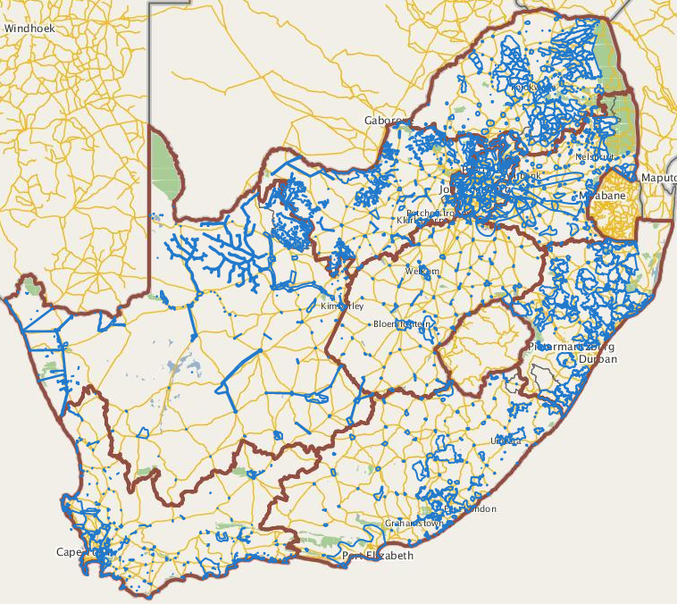
96% Infrastructure Coverage
1759 Municipal Water Schemes
institutional & management
implications ( 152 WSAs)
platform to inform:
  new development
  functionality / O&M
  asset management
  institutional arrangements

Slide 33
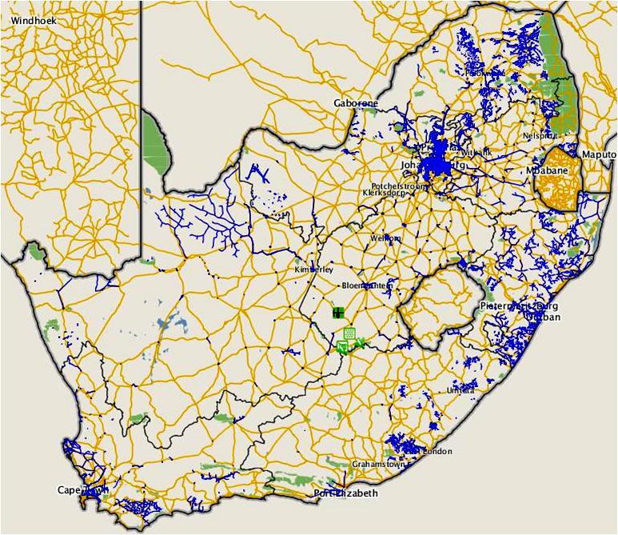
Extensive Water Services Infrastructure
Bulk pipelines > 35,000 km
Reticulation >200,000 km
(Johannesburg = 11,800km / Tshwane = 10,500km)

Slide 34
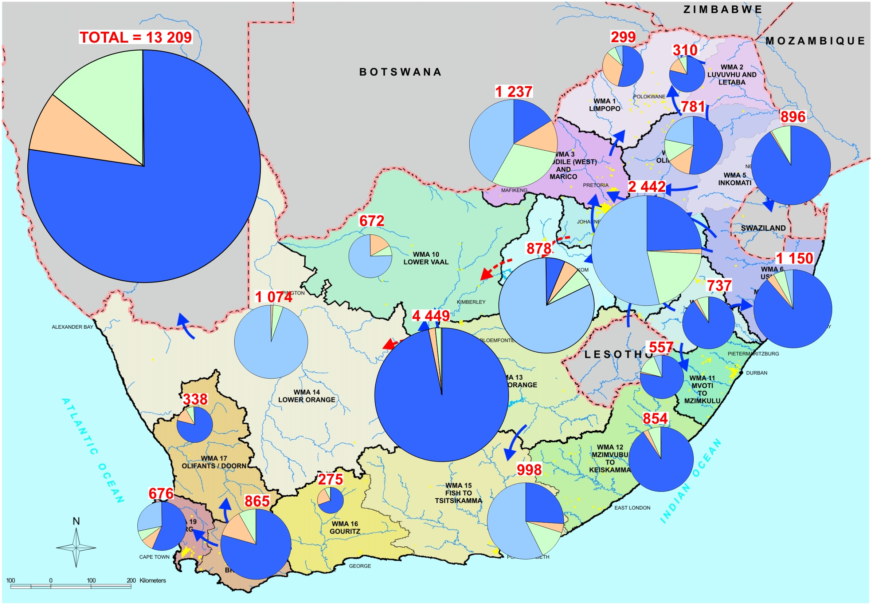
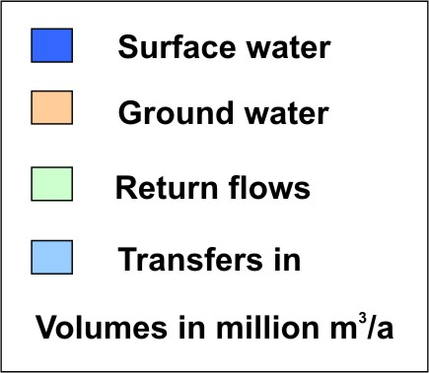
Water availability
Notes:
Diagram shows yield available, at 1:50 year assurance of supply, which is only the practically and economically usable portion of the MAR at current development levels and with water infrastructure (dams) as existed in year 2000.
Requirements for the ecological Reserve (which needs to remain in the rivers) already allowed for. Thus "water available" after providing for Reserve.
OBSERVATIONS
Dominance of surface water (± 80 %).
Re-use of return flows greater than groundwater use.
(Return flows to ocean not included).
80 % of water from 20 % of land area in south east of country.
Large transfers into drier areas.
"Transfers" to Lower Vaal, Lower Orange are releases along river from upstream.
NOTE: Yields given at standardised 98% assurance of supply (or 1 in 50 year risk of failure).

Slide 35
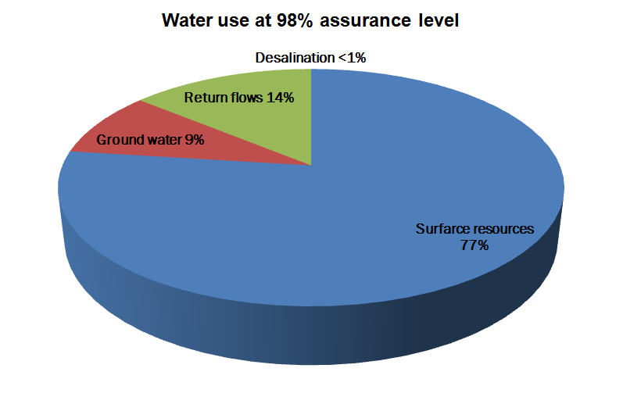
Current water resources mix
Extended resource mix
Notes:
South Africa is still heavily reliant of surface water and its development
Ground water reflects 9% use and is under utilised, under valued and not well managed.
At 14% re-use is already a major component of the water mix albeit mostly indirectly. Direct re-use especially in the coastal areas must be encouraged
There is a large scope of increasing desalination which is currently at less than 1%. Inland measures are in place to desalinate acid mine water and brackish water resources whilst coastal areas have an opportunity to desalinate sea water.
We are obliged to apply and improve integrated water resource management to ensure continued water security

Slide 36
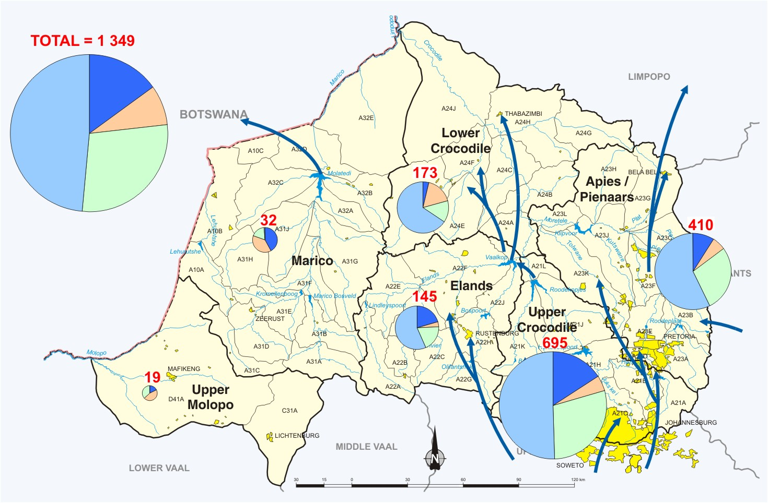
WMA 3: Crocodile West and Marico - Water Availability (2000)
Notes:
A CLOSER LOOK AT THE CROCODILE WEST AND MARICO WMA:
Nearly half of available water from transfers in
Close to 30 % from return flows which become available for re-use
(mainly originating from transfers).
Local natural resources within WMA less than 25 %.

Slide 37
4. Our water balance

Slide 38
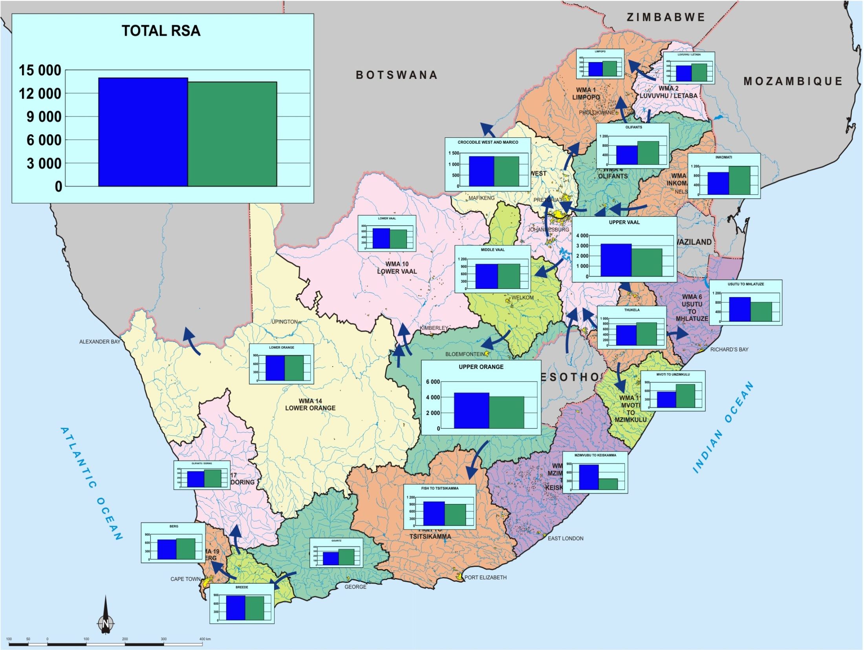
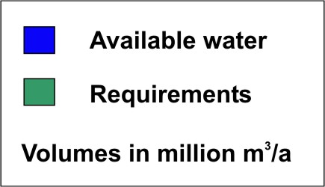
Is there enough where we need it?
Water reconciliation scenarios
Fresh water @ equilibrium
12 of 19 WMA require
intervention
Notes:
ON NATIONAL SCALE: Still a small surplus for the country. However, national total alone can be misleading because average does not show regional and local surpluses and/or deficits.
Note: Reserve quantity is included in the requirements.
Some WMAs in surplus (e.g. Upper Orange, Mzimvubu to Keiskamma)
Some WMAs in deficits (e.g. Mvoti to Umzimkulu, Berg).
Total RSA in surplus, however:
11 WMAs in deficits in 2000
8 WMAs in surplus in 2000
Important to note that the balances include the Reserve.
Further imbalances within WMAs, also within sub-areas.
BACKGROUND ONLY, SHOULD THE QUESTION BE ASKED:
Upper Vaal shows surplus, based on assuming maximum transfer capacity
In practice, however, only transfer water as needed.
TO PRESENTER: Do not spend too much time on this diagram, rather focus on "The Future“.

Slide 39
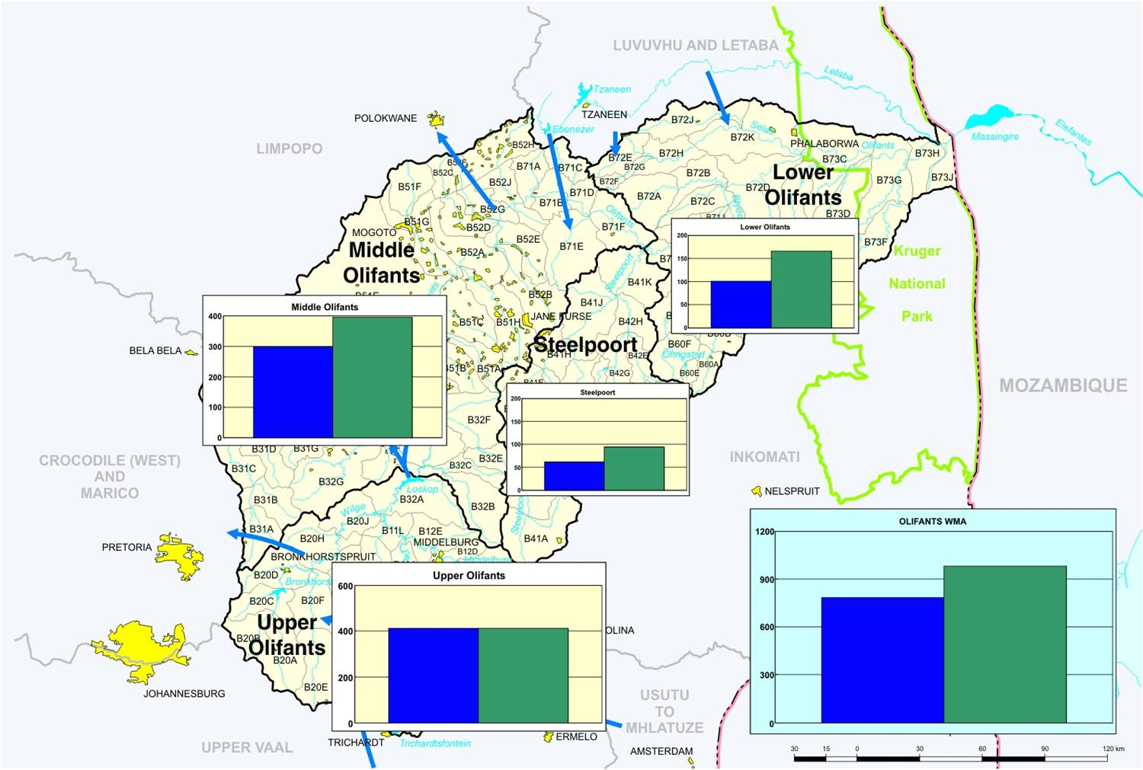
Olifants system
39

Slide 40
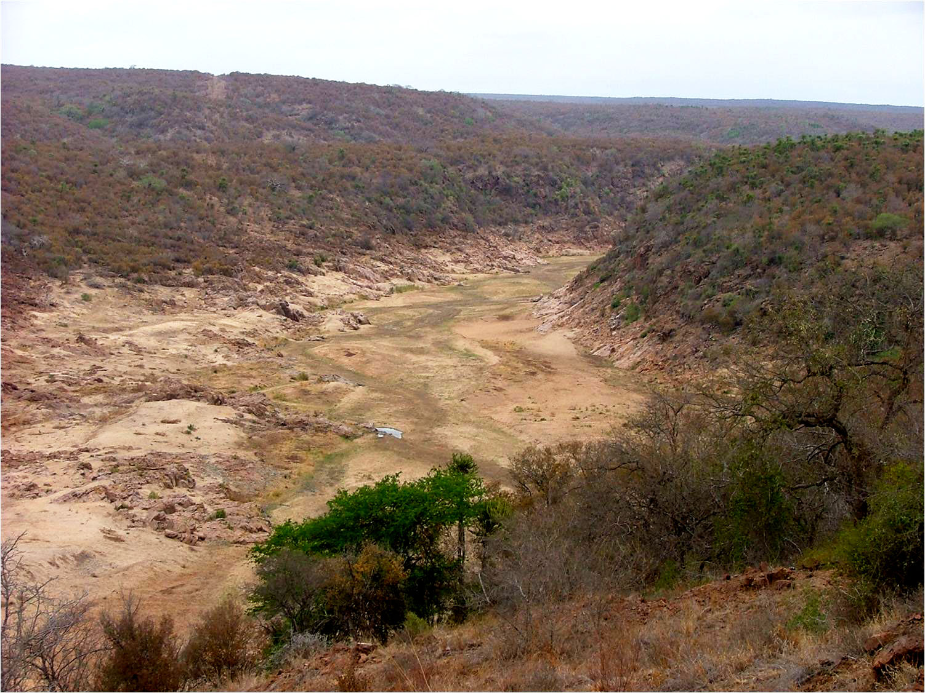
Kruger national Park: Olifants River 1983

Slide 41
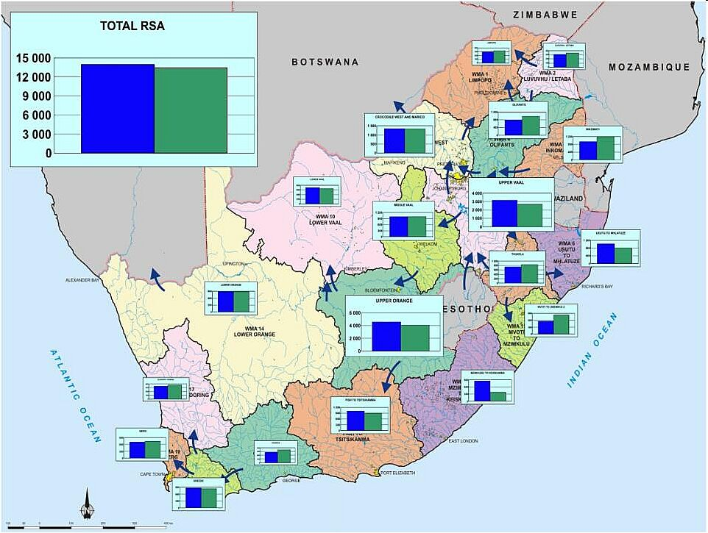

To increase transfers from Luvuvhu/Letaba
Nandoni Dam - completed
Raising Tzaneen Dam & Constructing Nwamitwa Dam
To use Increasing Return Flows in Crocodile (West) River System
De Hoop Dam - completed
Inyaka Dam - completed
Maguga & Driekoppies Dams - completed
LHWP 1 (Katse & Mohale Dams) - completed
Vioolsdrift Dam – under planning
LHWP 2 (Polihali Dam) – under implementation
Spring Grove Dam - completed
Hazelmere Dam Raising- under implementation
uMkhomazi Water Project (Smithfield Dam & tunnel) – under planning
Raising of Clanwilliam Dam – under implementation
Mzimvubu Water Project (Ntabelanga & Lalini Dams) – under implementation
Berg River Dam - completed
Development of major water resource projects since 1994
Water Balance 2004
Notes:
ON NATIONAL SCALE: Still a small surplus for the country. However, national total alone can be misleading because average does not show regional and local surpluses and/or deficits.
Note: Reserve quantity is included in the requirements.
Some WMAs in surplus (e.g. Upper Orange, Mzimvubu to Keiskamma)
Some WMAs in deficits (e.g. Mvoti to Umzimkulu, Berg).
Total RSA in surplus, however:
11 WMAs in deficits in 2000
8 WMAs in surplus in 2000
Important to note that the balances include the Reserve.

Slide 42
The reality situation!
!!!
Climate change: more variability:
stress on stress on stress on stressed
Future: More development:
increased needs plus impact
Major development:
Fresh water @ limit & pollution
Water stressed country:
High variability

Slide 43
5. And how are we responding to this water resource challenge?

Slide 44
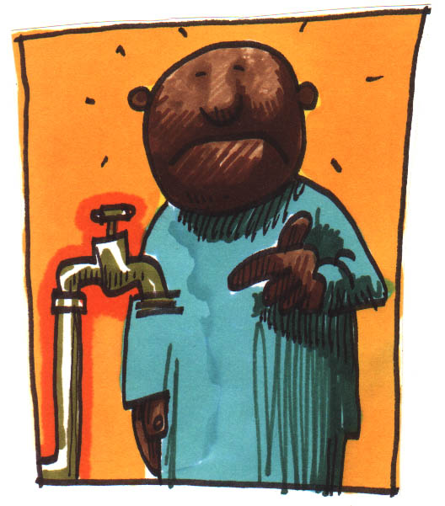
The Reality Experience

Slide 45
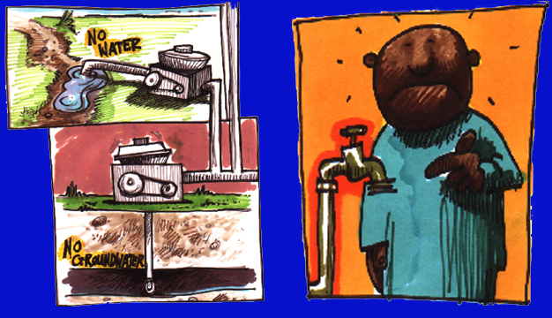

Slide 46
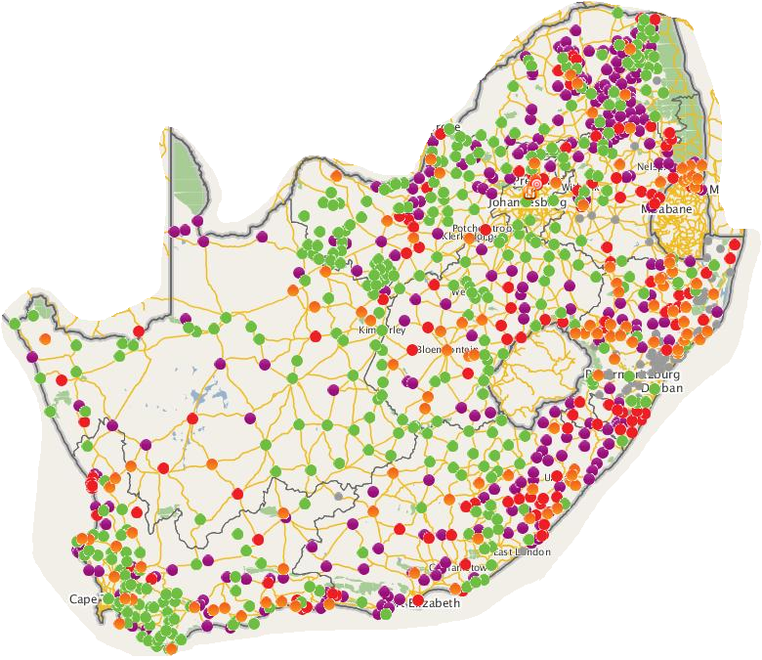
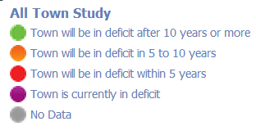
All Town studies: Water Resources
30% require urgent water resource security intervention
46

Slide 47
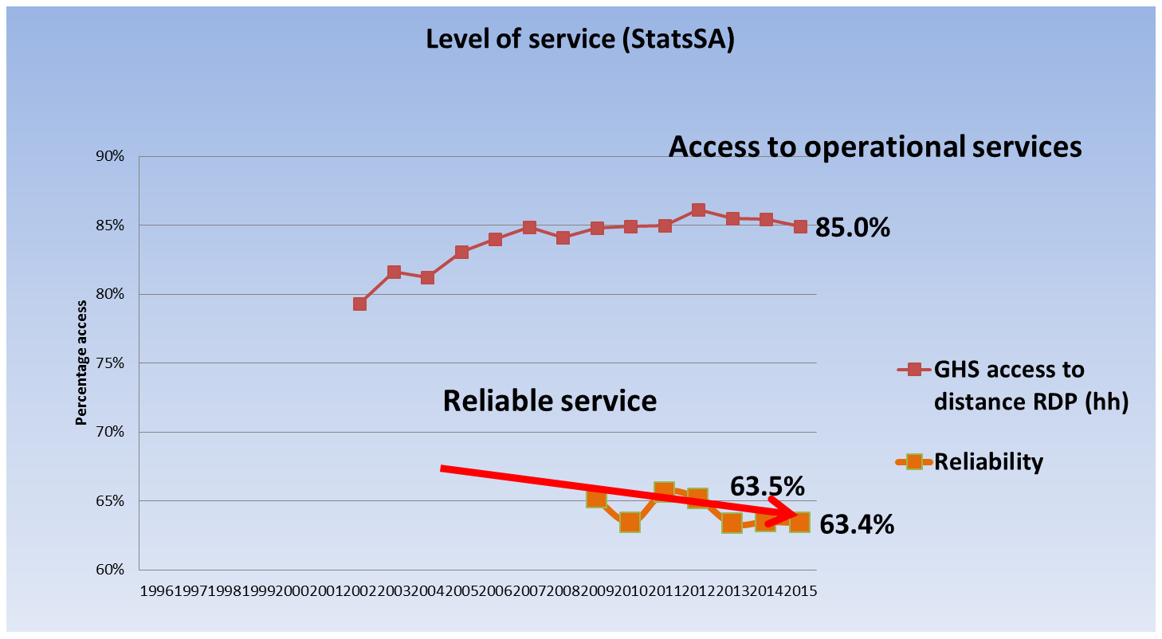
poor total progress: Delivery trends !!!(StatsSA)

Slide 48
The National Water Supply Situation
Access to RDP infrastructure
96%
11% dysfunctional
Access to RDP operational services
85%
Serious interruptions -20%
Access to RDP reliable services
65%
13 WSAs < 30%
Access to Reliable RDP 27 Priority DMs
42%

Slide 49
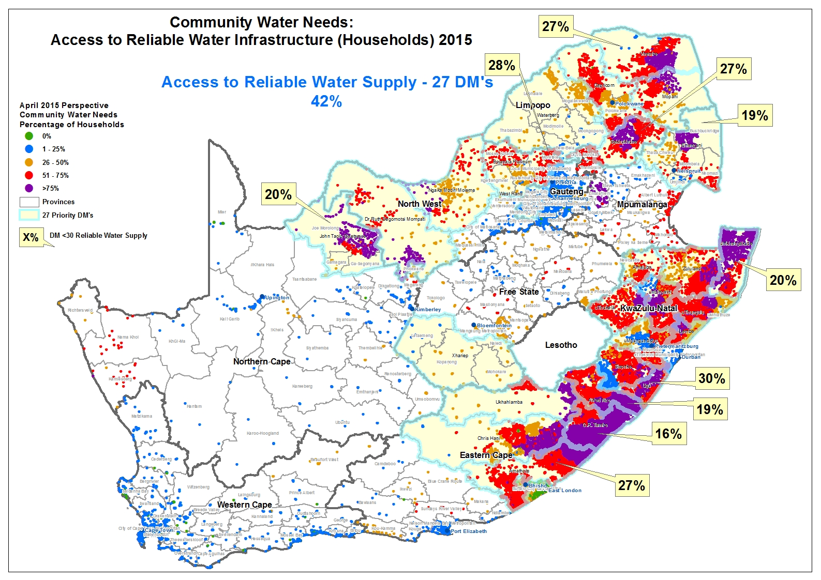

Slide 50
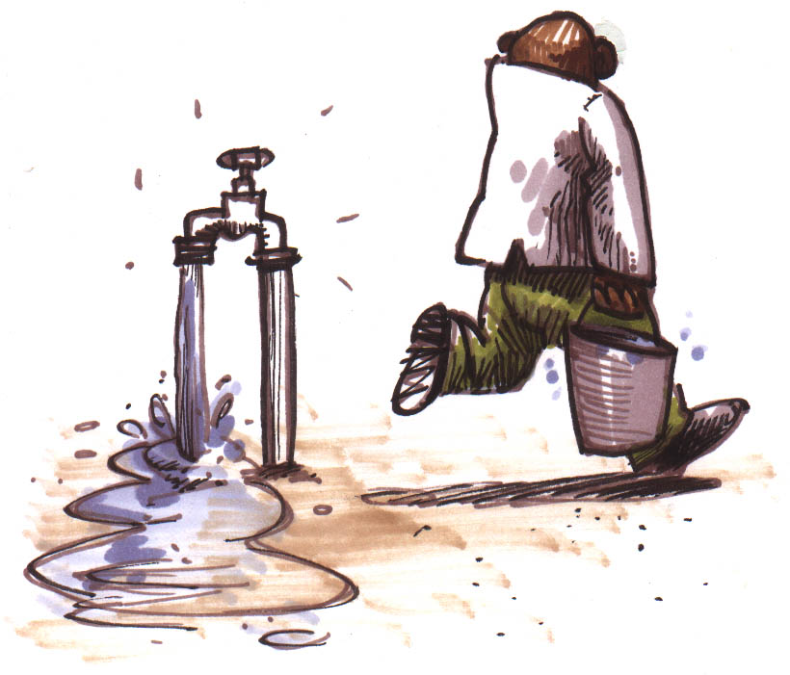
Water losses

Slide 51
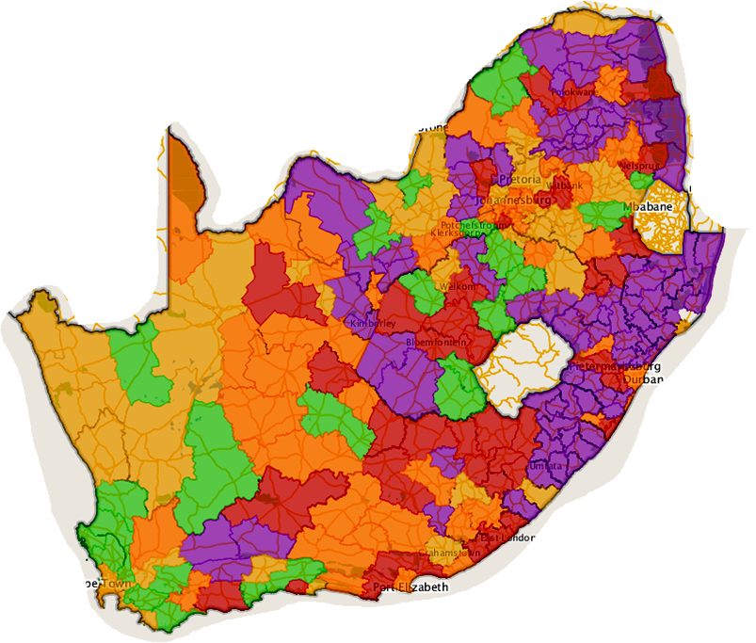
Non-Revenue Water
55% of lms above 40% NRW
70% no bulk meters/ limited knowledge
38%

Slide 52
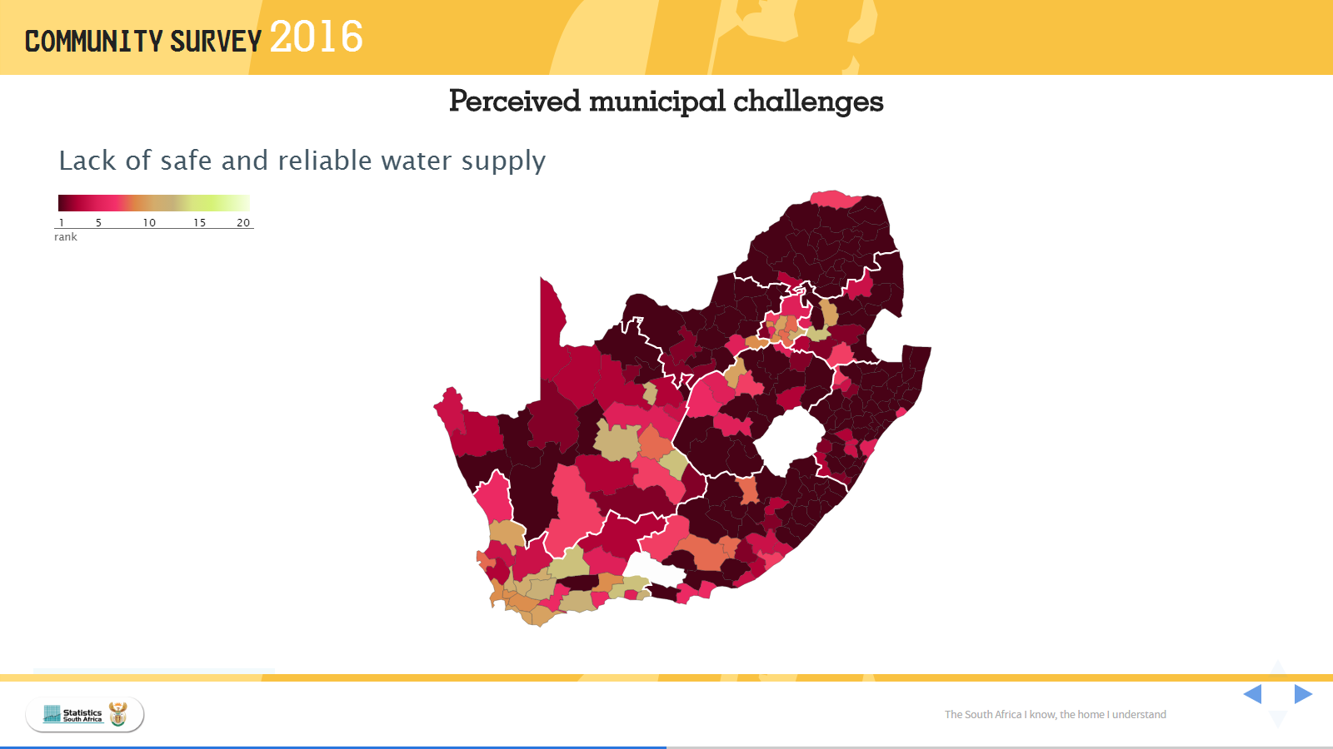


Slide 53
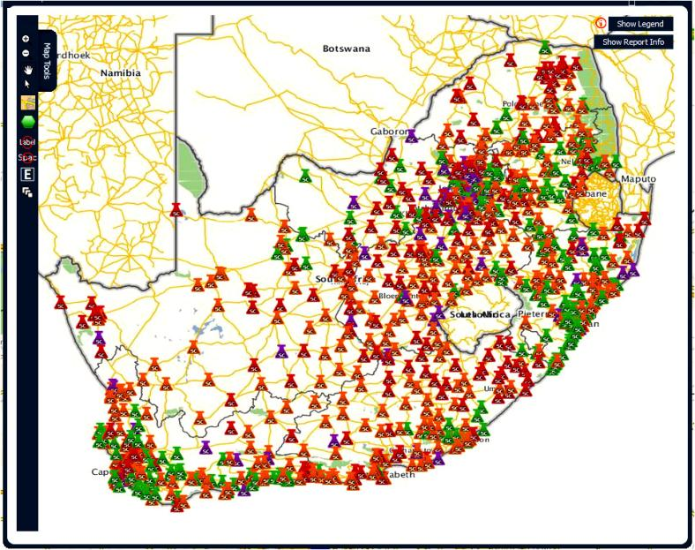
“High Risk Areas”: Wastewater Treatment Works : Performance Rating
26% good/excellent
44% very poor / critical
Total WWTW = 1174
824 municipal works
53
Notes:
This slide shows the location of all WWTWs comprising 1155 of which 824 are municipal works
53

Slide 54
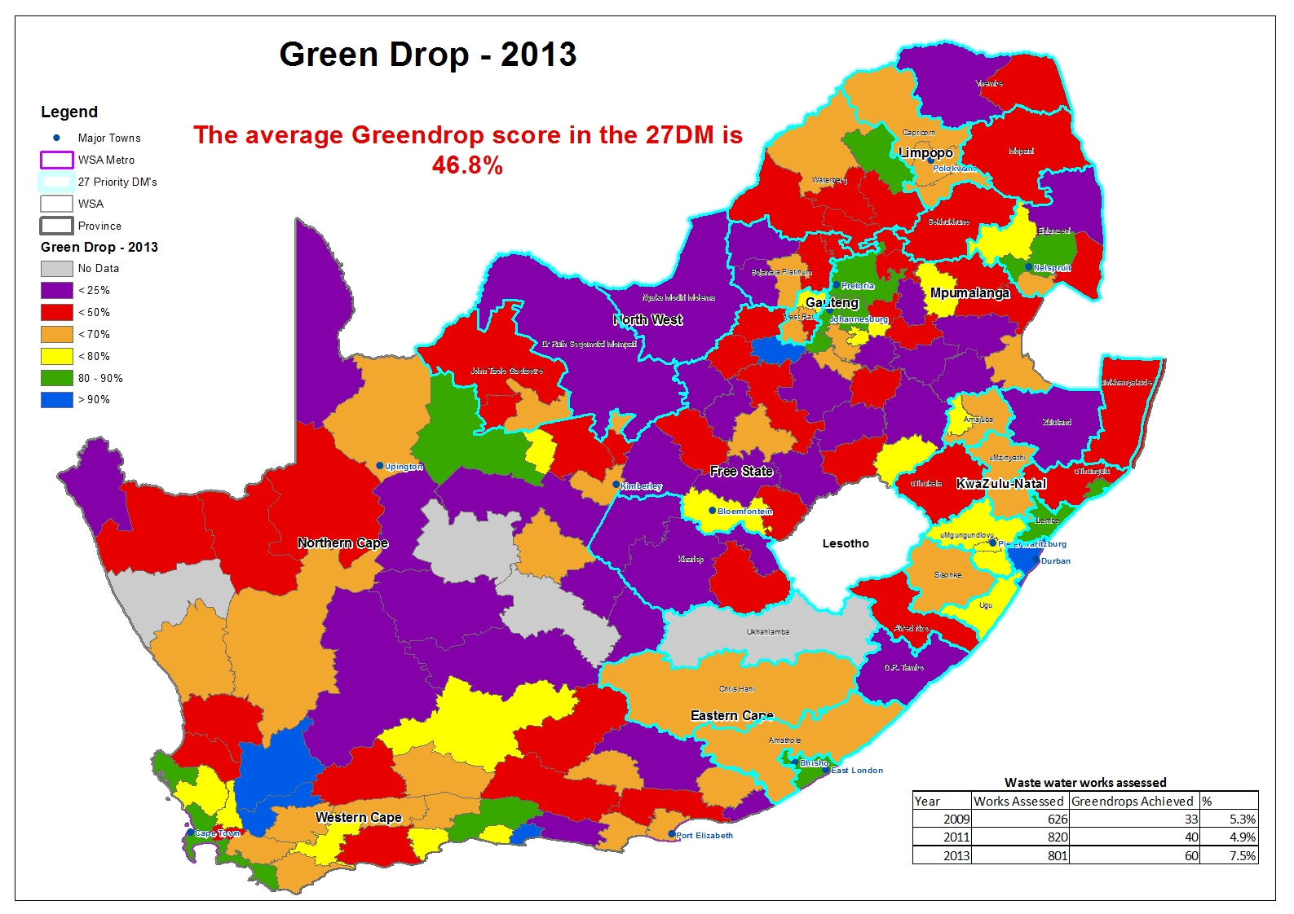

Slide 55
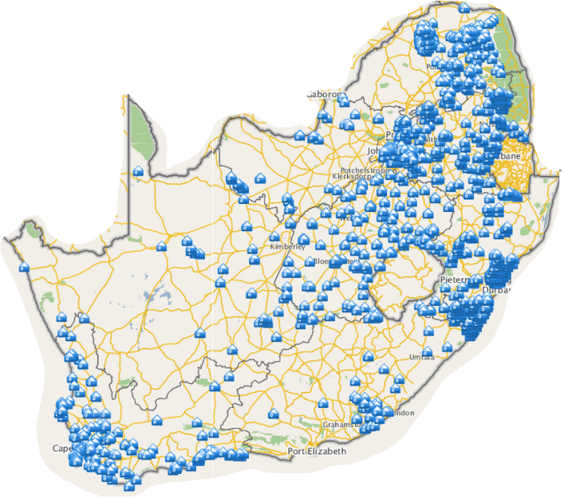
>3800 Pump stations
1400+ WWTWorks
Energy dependent
Count of Municipal Pump Stations
Province | Count
Eastern Cape Province | 175
Free State Province | 673
Gauteng Province | 448
KwaZulu-Natal Province | 335
Limpopo Province | 784
Mpumalanga Province | 432
North West Province | 50
Northern Cape Province | 166
Western Cape Province | 739
Grand Total | 3802

Slide 56
Extensive Renewal Requirement
(aged infrastructure)
Rehabilitation
30%
76%
42%
59%
36%

Slide 57
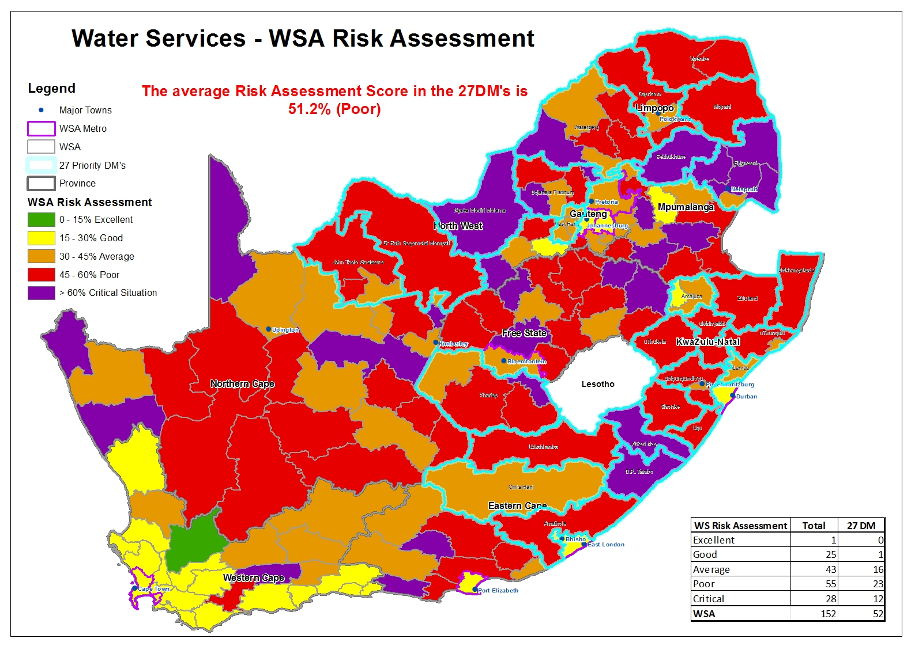
67% poor to critical

Slide 58
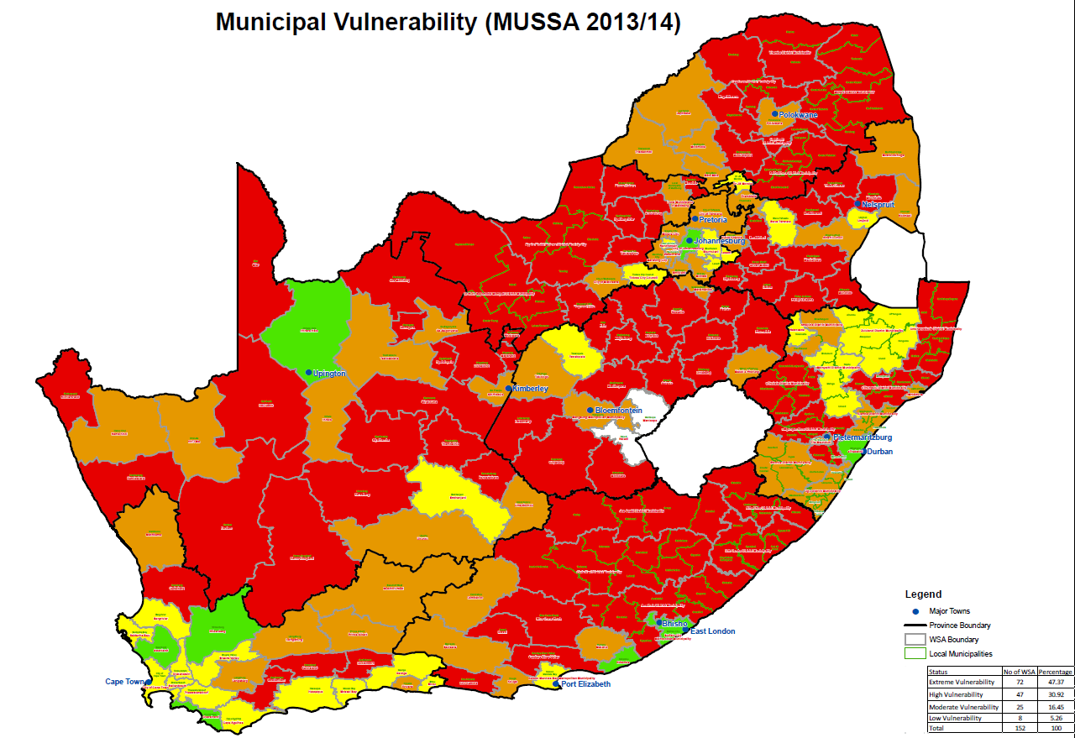
National:
78% high to extreme vulnerability

Slide 59
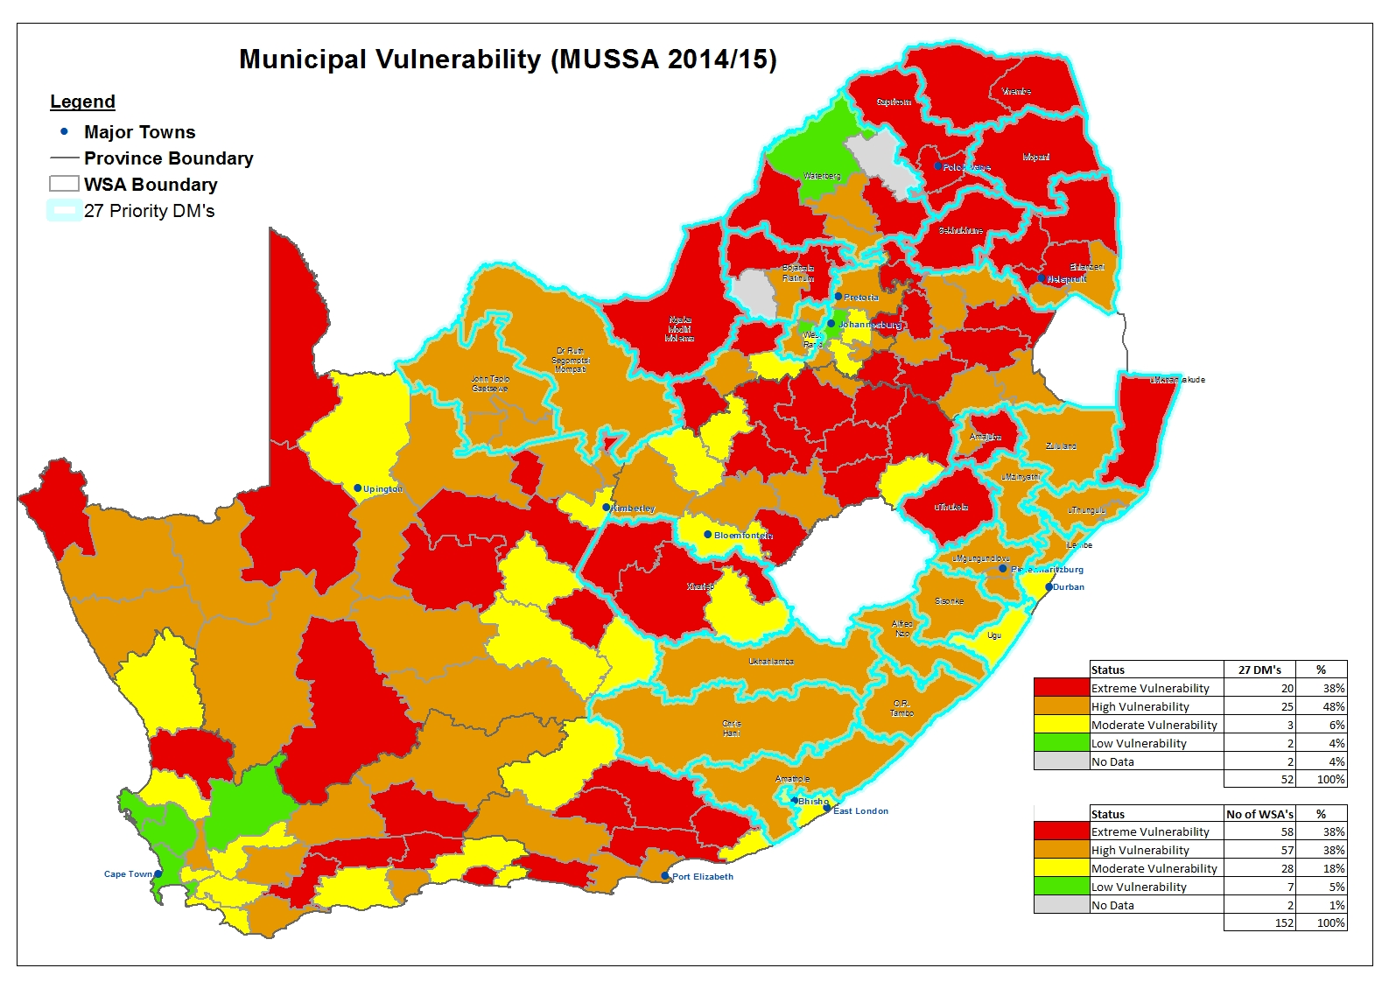
27 Priority DMs:
86% high to extreme vulnerability

Slide 60
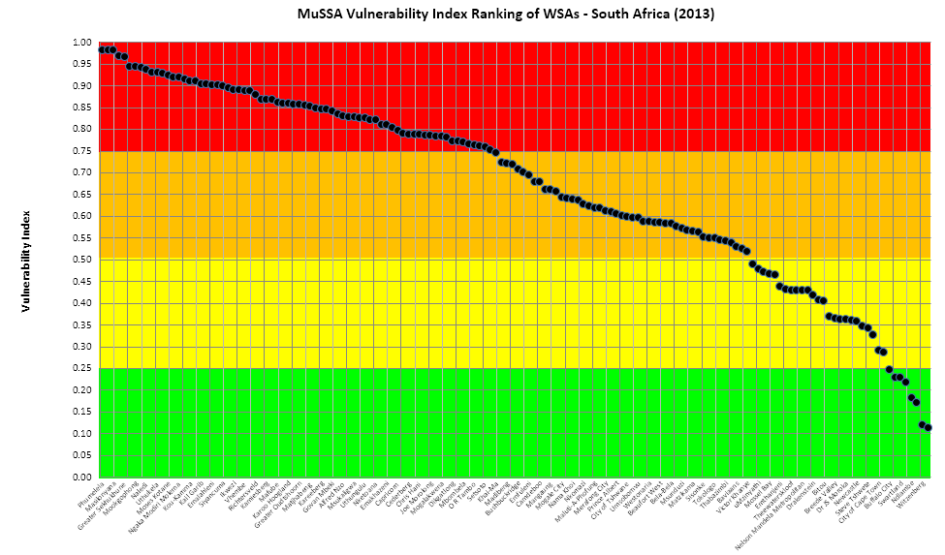
Municipal Vulnerability Index: SA

Slide 61
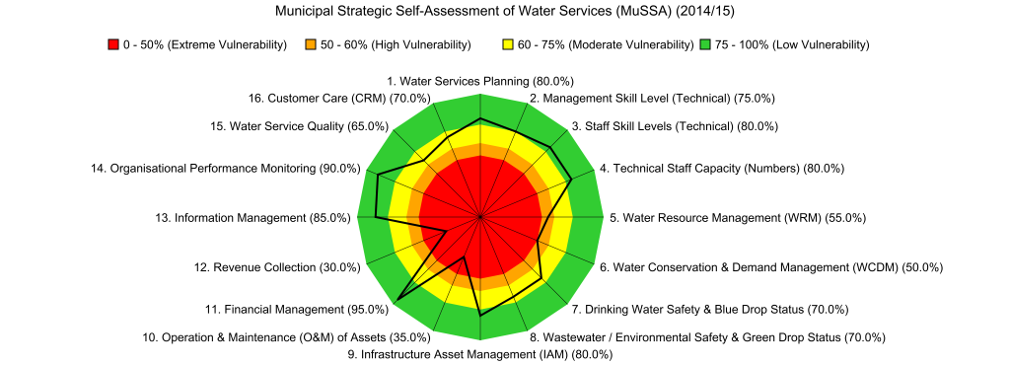

Governance and institutional capacity

Slide 62
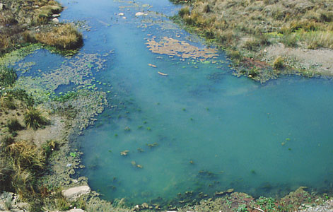
Water Quality… turquoise...

Slide 63
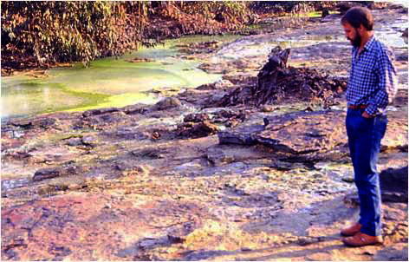
…to yellow...

Slide 64
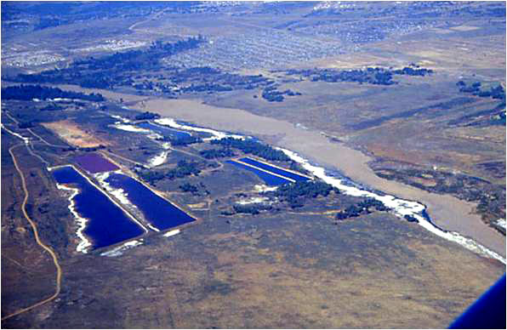
…to white...

Slide 65

Urban Pollution

Slide 66

Mining Pollution

Slide 67

The Hennops River … Sewer?

Slide 68



Freshwater ecosystems are in a poor state
Present ecological status 1999
  Only 30% intact (Class A or B)
River Health Programme
  Ongoing deterioration over a 12 year period
National Spatial Biodiversity Assessment 2004
  84% threatened, 50% critically
CR
EN
VU

Slide 69
The financial challenge
Total estimated replacement cost = R 1 700 billion
Estimated investment requirement * (10 years) = R 860billion * = R 86 billion per annum
Total funding available = R 46 billion per annum
Funding deficit = R 40 billion per annum
Refurbishment estimate = 46% of cost
New cost of water >R15/m3 (R25/m3 potable water)
O&M financing challenge

Slide 70
We have serious water concerns and challenges
Water security for growth and development
Inadequate sustainable services, vandalism
Water resource pollution
Disaster management and potential impact of climate change
Degradation of physical habitats and ecosystems (water resource sustainability)
Lack of appreciation for water, its role and situation
Poor water values and inadequate status
Inadequate management and governance
Corruption, incompetency

Slide 71
How will you describe the situation?
Emergency ?
Disaster ?
Crisis, Catastrophe ?
Danger, trouble, trauma ?
Distress and Anger

Slide 72
South Africa is @ the cross roads
South Africa at risk if water is not taken seriously and interventions not applied timeously

Slide 73
6. What now?

Slide 74
The legal and social mandate & obligation
The water resources of the Republic must be protected, used, developed, conserved, managed and controlled to ensure “prosperity”

Slide 75

Solution 1– Wait and pray for a miracle to happen

Slide 76


Slide 77
"Quality is never an accident; it is always the result of intelligent effort "
John Ruskin

Slide 78
We need:
-Appropriate solutions & interventions
-Focused and effective programmes,
-Implementation and action.
- Sustainable management requires effort !

Slide 79
Resource development protocol
Water conservation and demand management
Maximize local resource utilization (stretch our water):
  Use
  Management
  Groundwater utilization
Water Systems management and optimization (stretch)
Re-use; desalination
Resource protection
Bulk development (new)
Re-allocation

Slide 80
Our options
Systems/
risks
sea
need
Governance /
Regulation
Un-authorized use
Re-use
Use/ re-allocation
-Water loss
-Use efficiency
Surface Water
Ground water
Resource protection
Ground water
Surface Water
transfers
Notes:
`

Slide 81
Extended water resource:
& implications
Fresh Water
Ground water
Re-use
Sea
Import
direct
virtual
Resource optimization
Systems management
Extended value & strategic management
Water use efficiency
Re-allocation
Resource protection
Service levels/ allocation/ risks

Slide 82
Era of new “smart” management
Re-positioning strategic role of water
Application of sound business principles
New and innovative solutions
Implement integrated sector based water management model/Sector partnerships and involvement
Improved water governance, regulation and water sector leadership
New concepts: “water footprint”; “source to tap to source”; multipurpose development
Complex but practical management tools and decision making

Slide 83
7. And you?
What role are you playing?

Slide 84

Water Supply-Chain:
“Source-to-Tap-to-Source”
Municipal management
On site managment
Bulk water supply (water services management role 2)
2
3
1
4
Water resource management
5
Notes:
This slide illustrates the supply-chain from source-to-tap and tap-to-source in a practical illustration

Slide 85
Intervention areas
Water security:
  Water losses
  Effective use (technical, control systems, metering)
  Re-use (health risks)
  Storage (health risks)
Sanitation (safety, water use) (cost concern and bulk system impact)

Slide 86
Intervention areas
Water pollution management :
  Technology
  Protection
  Waste management
Storm water management

Slide 87
Challenges and concerns
Financial implications: cost and financing
Cost of water
Existing versus new intervention
Return flow impact
Heath risks (raw water and reuse)
Bulk systems impact: functionality
Technology standards and oversight
Control
Ineffective ideas
Sustainability and viability
Governance support & enablement

Slide 88
“The difference between a successful person and others is not a lack of strength, not a lack of knowledge, but rather in a lack of will”
Vincent T. Lombardi

Slide 89

Thank you

