Slide 1
NRCS Annual Building Control Officers Convention 2018
Doing Business Regulatory Reform
How to develop a Customer Centric Permitting System:
22 November 2018

Slide 2
South Africa

Slide 3
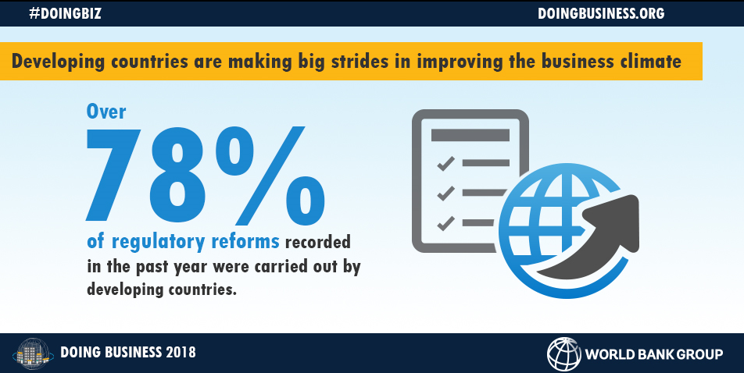
What does Doing Business measure?
Doing Business indicators:
Focus on regulations relevant to the life cycle of a small to medium-size domestic business.
Are built on standardized case scenarios.
Are measured for the largest business city in each economy, and the second largest business city in countries with more than 100 million inhabitants as of 2013.
Are focused on the formal sector.
“Job creation is one of the transformational gains that countries and communities can achieve when the private sector is allowed to flourish. Fair, efficient and transparent rules, which Doing Business promotes, improve governance and tackle corruption”
Kristalina Georgieva, World Bank Chief Executive Officer
http://www.doingbusiness.org/
Notes:
Doing Business does not measure all aspects of the business environment such as security, macro-economic stability, prevalence of bribery and corruption, level of training and skills of the labor force, proximity to markets, regulations specific to foreign investment or the state of the financial system.

Slide 4
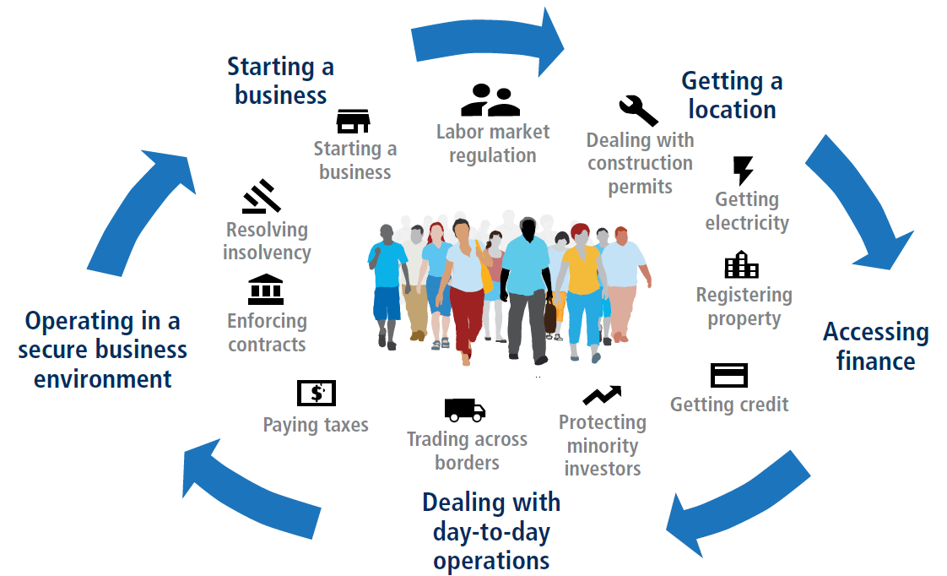
The 11 Doing Business areas of business regulation affect firms throughout their life cycle
City governments are responsible for 3 Doing Business indicators – all in area of Getting a Location
Dealing with Construction Permits
Getting Electricity
Registering Property
New

Slide 5
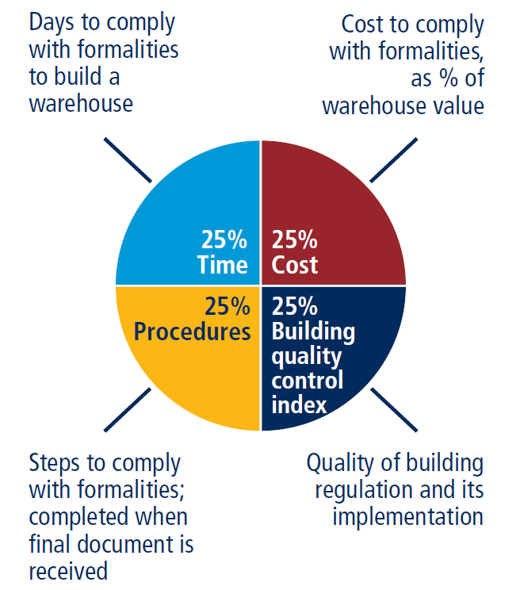
What Dealing with construction permits indicator measures
What are the number of procedures, time and cost for a small and medium-size limited liability company to build a standardized warehouse? What are the building regulations and how are they implemented?
efficiency
quality
New
5
www.doingbusiness.org

Slide 6
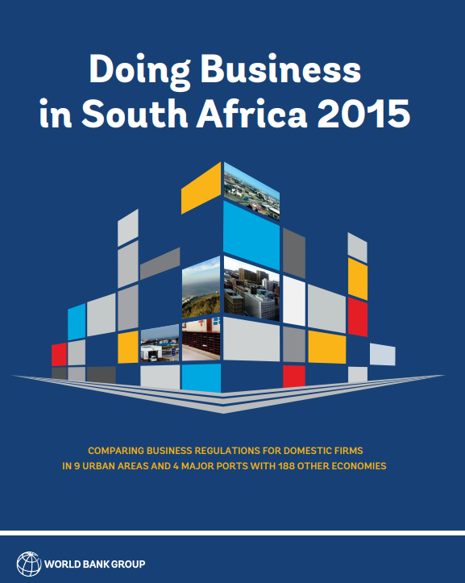
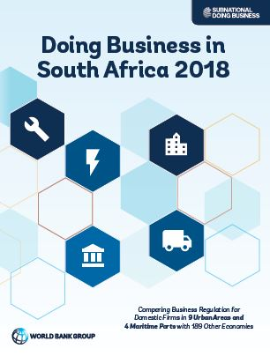
The Doing Business in South Africa series
DB in SA I
DB in SA II
Measures 9 metro areas + 4 maritime ports
Updated data in 5 indicators regulatory areas measured in 2015
Applies methodology updates since 2015
Tracks and documents reforms
Identifies good practices and provides policy recommendations
www.doingbusiness.org

Slide 7
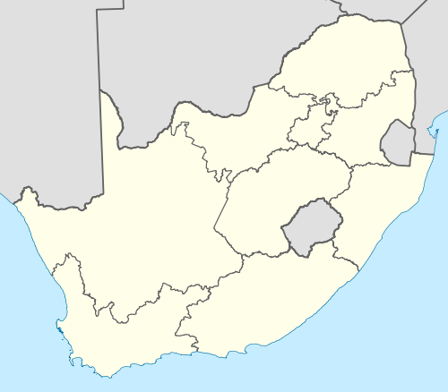
Second benchmarking in 9 urban areas and 4 maritime ports
9 Urban Areas
Buffalo City (East London)
Cape Town (Cape Town)
Ekurhuleni (Germiston)
eThekwini (Durban)
Johannesburg (Johannesburg)
Mangaung (Bloemfontein)
Msunduzi (Pietermaritzburg)
Nelson Mandela Bay (Port Elizabeth)
Tshwane (Pretoria)
4 maritime ports
Cape Town
Durban
Ngqura
Port Elizabeth

Slide 8
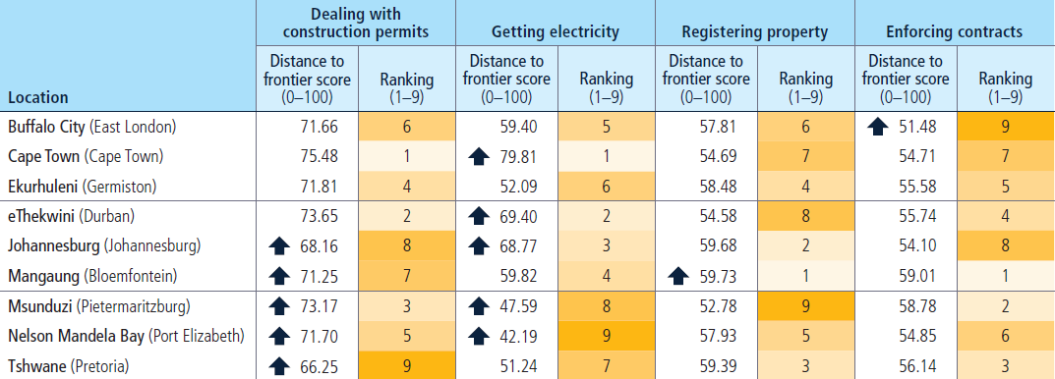
No location has the top performance in all areas
Notes:
Measure is based on 4 components: time, cost and number of procedures + quality dimension – each weighted equally
Rank is comparative of 9 SA cities
More NB is the Distance to Frontier (DTF) or the distance to the global best practice = 100. So lower scores here reflect declining performance

Slide 9
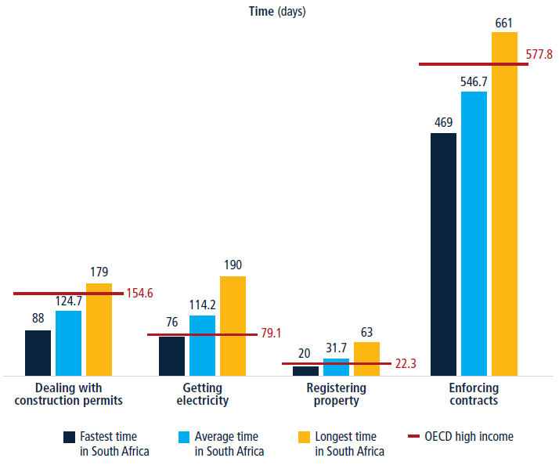
Processes are still complex and costly, however they are relatively fast

Slide 10
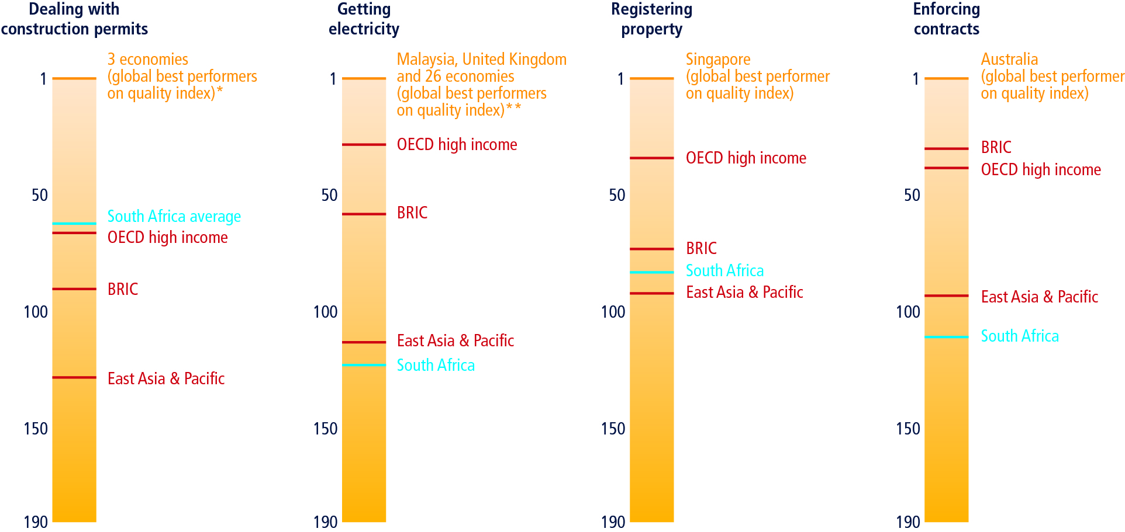
There is still room for improvement in the quality of regulation

Slide 11
The way forward: addressing cross-cutting issues
Coordination within municipalities
Collaboration at different levels of government
Proper resource allocation and implementation
Improved prospect for future reform successes
Between City departments (e.g. land use management, building control)
City & national level as national gov. responsible for legislative & regulatory policy reform
Budgeting for reforms such as automation & skill upgrading

Slide 12
BCO Conference: Dealing with Construction Permits – Quick Wins
22 November 2018

Slide 13
Quick Wins
Quality
Website (How to? Checklists, Videos, GIS, FAQs, Contact Us)
Risk Based classification
Stakeholder Engagements
Process Optimisations
One Stop Shop
MoEs
Turnaround times
Peer Learning

Slide 14
Medium Term Actions
NBR – change the Laws
Risk classifications on Safety
Insurance and legal liability
Risk based inspections
Online Permitting Systems

Slide 15
A Scenario
What information can we provide upfront so that we can receive quality submissions?
28 days
30 days
10 days
4 days
How are we gonna measure all of this?
Which MoEs can come to the MetroLink and which days? Pilot? Who can’t – and what’s the alternatives?
High density Residential
Single Point of Entry
Commercial/ Industrial
Approve SDP
Approve BP
Start Building
During Building
After building
Retail
❷
How can we have lesser steps to Water?
JRA
Apply for Water
Receive Final inspections - BC
How can we reduce the # of inspections?
Architect to sign off Town Planning requirements are met
❸
Educational
❶
Receive Inspection from Water
When do we really need an SDP?
How fast can we approve it?
Water
Receive Fire inspections
Fire
Recreational
❹
Receive final water connection
City Power
Receive inspections - BC
Issue OC
How can we reduce these days?
Warehouse
etc
Notify DoL
Receive inspections - DoL
How do we re-organise to approve building plans fast with compromising on safety and quality? What’s the risk?
Notify Municipality when started
Notify Municipality when finished
How can we reduce these steps?
Do we Pend or Reject?

Slide 16
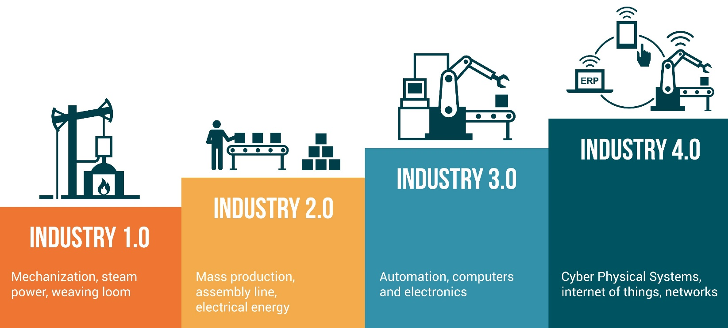

Slide 17
Impact Of 4IR
Growth
Efficiency
Skills Gap
Security Threats
Changes in employment
Changes in equality

Slide 18
Artificial Intelligence

Slide 19
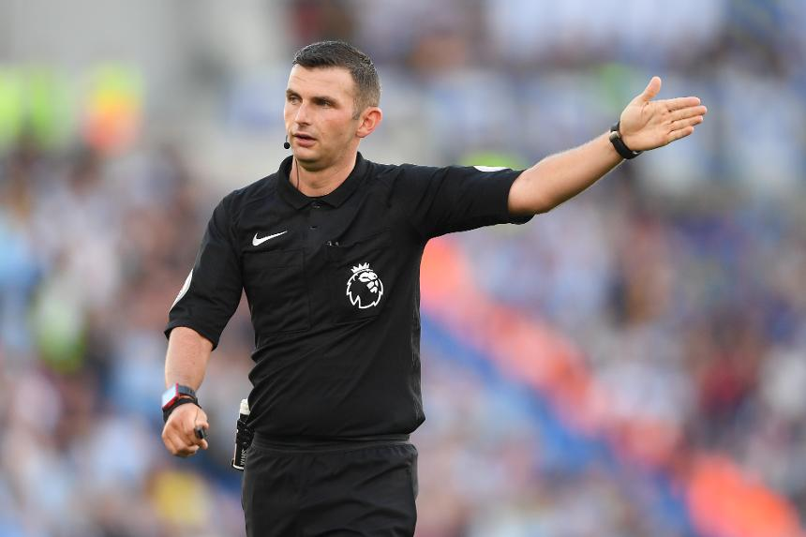
Jobs Prone To Automation

Slide 20
Impact of AI
Positive
Rational Data Driven Decision making
Negative
Accountability
Removal of “irrational exuberance”
Job gains & innovation
Energy independence
Job losses
Cyber crime
Becoming incomprehensive
Existential threat to humanity
Notes:
The Fourth Industrial Revolution – Klaus Schwab

Slide 21
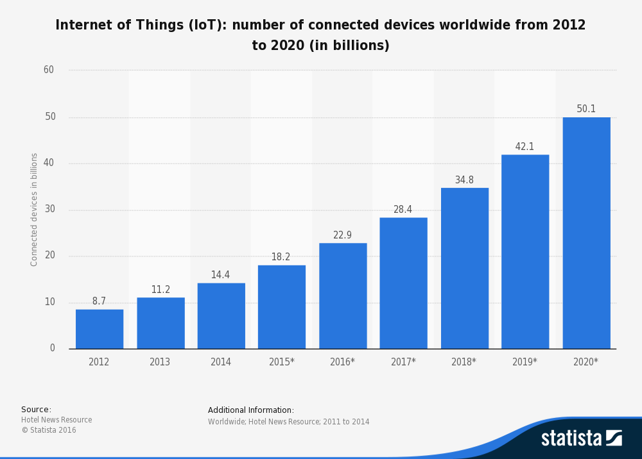
What is IoT?
The Internet of Things, or IoT, refers to the billions of physical devices around the world that are now connected to the internet, collecting and sharing data.

Slide 22
Notes:
https://www.arcweb.com/industries/smart-cities

