Slide 1
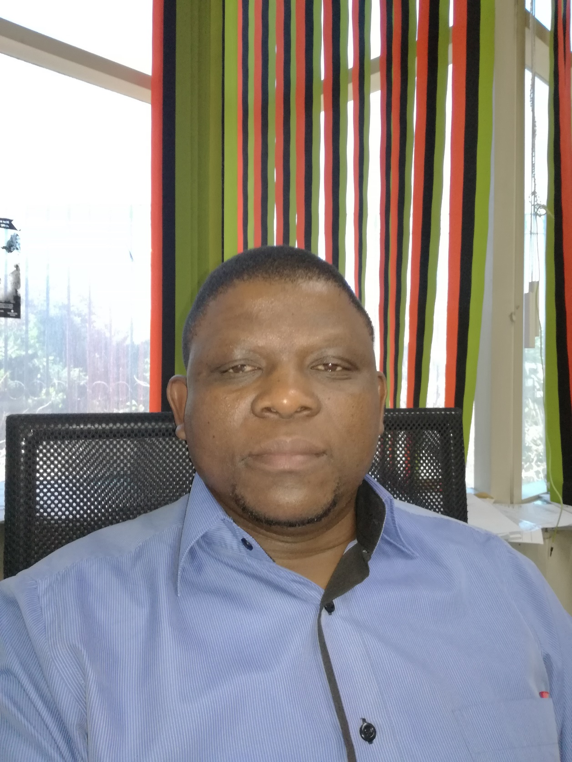
BRODERICK
CHILOANE

Slide 2
CONVENTION THEME:
Transformation towards a Sustainable Built Environment

Slide 3
TOPIC: Reflections from the Building Control Officers’
Steering Committee
PRESENTED TO THE 8th BCO CONVENTION: CITY OF JOBURG: 22 NOVEMBER 2018
AUTHOR & PRESENTER: BRODERICK CHILOANE
MANAGER: BUILDING AND ZONING CONTROL
MANGAUNG METROPOLITAN MUNICIPALITY

Slide 4
INTEND AND PURPOSE OF HOLDING THE ANNUAL BCO’s CONVENTION/ QUARTErLY STEERCO. MEETINGS
TO GIVE EFFECT TO THE TERMS OF REFERENCE OF BCO STEERing COmmittee.

Slide 5
INTEND AND PURPOSE CONTI….
BUILDING CONTROL OFFICERS STEERING COMMITTEE (BCOSC)
TERMS OF REFERENCE
1. INTRODUCTION AND BACKGROUND
The Building Control Officers Steering Committee (BCOSC) was developed as an identified building industry stakeholder of the National Building Regulations Department (NBR) of the National Regulator for Compulsory Specifications (NRCS). The committee was constituted at the first Building Control Officers Convention held in 2009.
The NRCS’s NBR unit is responsible to the minister of Trade and industries to ensure the uniform understanding, interpretation and implementation of the National Building Regulation and Building Standards Act. The BCO is responsible to implement and interpret the NBR on behalf of the minister and advise the local authority to refuse or approve building applications.
The Building Control Officers are employed by the Local Government and is a statutory required appointment in terms of the NBR. The intension of establishing the BCOSC is to seek collaboration as equal partners.

Slide 6
INTEND AND PURPOSE CONTI….
BUILDING CONTROL OFFICERS STEERING COMMITTEE (BCOSC)
TERMS OF REFERENCE
2. PURPOSE
The objective of the Steering Committee is to maintain a communication platform between the NRCS, the dti, Building Control Officers, and Local Authorities. To promote national uniformity in terms of interpretation and application of NBR &BS Act and other applicable regulations by:
• Identifying weaknesses and shortcomings in Building Control environment in South Africa as well as proposing and adopting solutions.
• Actively promoting the image and status of the BCO’s in S.A.
• Ensuring effective communication and information flow.
• On-going monitoring, review and improvement of the NBR BS Act and other relevant regulations through service and enforcement initiatives.
• Actively participate, motivate, and actively influence formulation of new/ amended legislation(s).
• Sharing and distributing knowledge and experience through continual professional development.
• Acknowledging and upholding the principle of Batho Pele.
• To organize annual BCO Convention, its advertisement and accompanying media conferences

Slide 7
STRATEGIC ROLE AND POSITION STATEMENT OF BUILDING
CONTROL IN A LOCAL AUTHORITY, TIER OF GOVERMENT
The strategic role of building control is that of regulatory, catalytic and enablement of the built environment concomitantly giving value to the biggest physical assets in property and infrastructure, thereby contributing to the revenue base of Local Authority as well as the economic health of South Africa and the world over.

Slide 8
mile stones achieved, bcosc
Successfully hosted 7 Conventions across the South Africa.
Successfully hosted all quarterly BCOSC across the South Africa.
Refined and adopted Terms of Reference (TORs)
Draft BCOSC constitution (Living document)
Actively participating in the current revision of the NBR.
BCOSC is Represented in the T60 Technical committees of SABS.
Currently engaging with SACAPSA to professionalise building inspector across all sectors( eg Banks, Housing, NHBRC, Private Home inspectors, etc.) & categorization thereof.
Currently working on standardisation of building plans and related application forms.

Slide 9
mile stones achieved, bcosc
9. Actively participating in the LgwSeta to design a course for Building inspector,
development is at an advanced stage.
10. Addressed some challenges faced by some municipalities in collaboration with NRCS.
11. Shared and deliberated on Case studies of decided building control related cases.
12. Liaised with NRCS and DTI on matters affecting Building Control within LA.
13. Website available for NBR on NRCS website populated with BCOSC matters, presentations, papers, cases, Q&As
14. Outreach program in collaboration with NRCS & DTI to smaller municipalities.
15 Hosting of successful training workshops across SA facilitated and conducted by NRCS

Slide 10
Challenges facing Building control
At la level
Human Resources and capacity constrains
Processes optimization challenges, manual systems(building plan and related processes)
Operational efficiency challenges, hindrance to investment and development
Very limited utilization of artificial Intelligence (AI) Few LA have Automated system
Lacking behind in technological advancement whilst other sectors are advancing.
Constrained Competitiveness, SNDB SA, World bank
Make a business case for business process management.

Slide 11
Local Authority (LA) revenue base
Municipal Property rates Act (MPRA)
Besides equitable share, fines, issued bonds, grants etc.
Biggest share of LA revenue base start at PLANNING & Building Control.
Value of property (land) + improvements (buildings & infrastructure)=determine payable rates
Vacant site> development applications(bulk contributions) + building plan > construction process & building inspection > completed building>certificate of occupancy>valuation property = revenue (services consumption, rates and taxes etc)
Direct proportion of rates to value of property per determined formula
From interactions: Most local Authorities Building Control is direly short staffed posing a very serious challenge for the execution of the statutory mandate as obliged.
It is therefor critically imperative that Building Control be adequately resourced and capacitated

Slide 12
Economic Contribution
Procurement of professional services
Production of all building materials
Procurement of Building Material
Job creation during construction of buildings
Economic Life time use of buildings
Revenue through Consumption of services
Value chain realise

Slide 13
Economic Contribution
Procurement of professional services
Production of all building materials
Procurement of Building Material
Job creation during construction of buildings
Economic Life time use of buildings
Revenue through Consumption of services
Value chain realise

Slide 14
CLIMATE CHANGE IS A REALITY
ELNINO
TROPICAL CYCLONES
TSUNAMY
HURRICANES STORMS
MELTING OF THE ICEBERG
FLOODS
INCREASE INTEMPERATURES
CAUSEs UNTOLD DESTRUCTIONS

Slide 15
Resources utilization & challenges
Energy Efficiency
Electricity and energy challenges facing SA (load shading)
Buildings consumes more than 60% of our Energy
SA is dependent of fossil fuel based energy which is being depleted, as well as causing environmental damage through carbon emissions and foot print
Mines and open casts not properly rehabilitated, acid mine drainage challenges, the potential of closed mines not fully explored.
The Nerve/nucleus center of implementing the energy efficiency laws within is the built environment
Renewable energy is the way given the free South African sun and wind along our coasts
SA Positive DEV. Government and Independent power producers’ have SIGN A partnerships agreement worth billions of rands to feed the national energy grid.
Development and economic growth depend on availability of electricity

Slide 16
Sustainability through design and legislation
Building plans to comply with Legislation, Part XA, Sans 204, Solar water heating, Renewable energy, utilization solar water heaters, solar panels for generating renewable electricity, orientation of buildings, retrofitting low voltage energy efficient lights, installation of occupational sensors for lights in buildings, cavity wall, water harvesting, utilization of grey water for irrigation other purposes.
Insulation and Lighting of Buildings
Housing Sector has made major milestones in embracing green initiative leading to green buildings with modern structures and technologies. These efforts are aimed at adapting to adverse effects of climate change and ensure climate proof buildings and infrastructure
Green Buildings
innovative, resource efficient, low carbon technologies and infrastructure.
Adaptation/ retrofitting

Slide 17
Sustainable developments
What is sustainable development
"Sustainable development is development that meets the needs of the present, without compromising the ability of future generations to meet their own needs."
The concept of sustainable development can be interpreted in many different ways, but at its core is an approach to development that looks to balance different,
and often competing, needs against an awareness of the environmental, social and economic limitations we face as a society. Sustainable development is the organizing principle for meeting human development goals while at the same time sustaining the ability of natural systems to provide the natural resources and ecosystem services upon which the economy and society depends . The desired result is a state of society where living conditions and resource use continue to meet human needs without undermining the integrity and stability of the natural system. Sustainable development can be classified as development that meets the needs of the present without compromising the ability of future generations

Slide 18
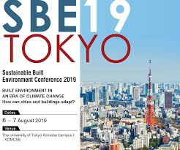
the world is concern

Slide 19
The balancing act

Slide 20
The balancing act
COJ ISSUED GREEN BONDS
TO FINANCE THEIR SUSTAINABLE
PROGRAMS
NON- MOTORISED LANES INTRODUCED ACROSS MAJOR CITIES IN sa.
INTERGRATED TRANSPORT SYSTEMS

Slide 21
The balancing act
It is in your hand to save the planet

Slide 22
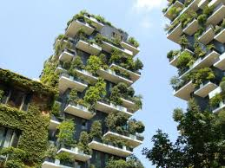
The balancing act

Slide 23
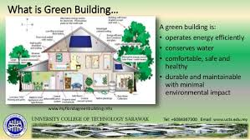
The balancing act

Slide 24
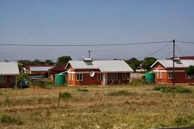
The balancing act

Slide 25
Water essential resource
SA is a water scarce Country
The devastating draughts experienced the past few years and still
Affected food production with its economic ripple effect-
Water rationing , dreaded day zero in City of Cape Town.
No matter the advancement in education & technology we cannot manufacture water, use sparingly
Sans 252 Water use in Buildings
Pollution of water sources EG current raw sewage in the Vaal river is a seriouse cause for concern.
World war III over resources HASH TAG WATER

Slide 26
Q&A

Slide 27
Thank you

