Slide 1

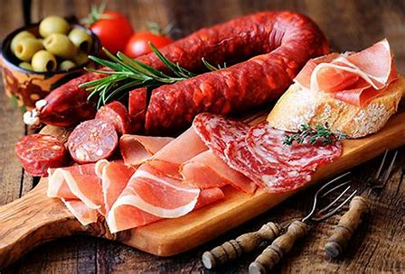
IMPLEMENTATION OF PROCESSED MEAT COMPULSORY SPECIFICATION(VC 9100)

Slide 2

Presentation outline
Background
NRCS Implementation plan and Enforcement Strategy
Scope of the compulsory specification VC 9100
SANS 885 requirements
Inspection plan
Key focus areas of SANS 885
Conclusions

Slide 3
Background
Publication of the VC 9100 by the Minister on 2019-08-08
Latest published SANS 885:2011
Implementation after 2 months on 2019-10-08
NRCS Implementation Strategy and Plan
Phased in approach of the enforcement plan

Slide 4
Implementation Plan
Registration of operators on the NRCS website
Registration is compulsory for processors, manufacturers, Importers and butcheries in terms of clause 2.25 of VC 9100
Approval of operators-continuous process conducted in phases
Inspections, sampling and testing
Awareness workshops- familiarization of industry with VC and SANS requirements

Slide 5
VC Requirements
Scope
Definitions
General Administrative requirements
Specific requirements
Application for approval of factories and processed meat products-Annex A
Application for Approval of Imported Processed Meat Products
Application for Export of Processed Meat Products
Granting and Withdrawal of Approval

Slide 6
VC Requirements
Scope: VC applies to the handling, preparation, processing, packaging, refrigeration, freezing, chilling, labeling, marking and storage of heat treated and RTE processed meat products covered in the scope of SANS 885, processed meat products; and it includes the microbiological and food safety related compositional requirements of these products
Processed meat classes:
Whole muscle, cured , heat treated products
Whole muscle, uncured, heat treated or partial heat treated and RTE products
Comminuted, cured, heat treated products
Comminuted, uncured and heat treated products
Reformed, cured, heat treated products
Any other unspecified RTE processed meat products
RTE products which are not cooked before consumption such as salami, excluding dried and fermented processed meat products

Slide 7
NRCS Local and Export Core Inspection Processes
Registration
Monitoring
Control
Approval
Establishment Inspection
Market Surveillance Inspection
Sampling
Product Inspection
Testing
Non-compliance
Sanctioning
Compliance
Approval/Certification

Slide 8
NRCS Import Core Inspection Processes
Registration
Detain by Port Health
Monitoring
Control
Verification of consignment at Importer
Market Surveillance Inspection
Sampling
Product Inspection
Testing
Non-compliance
Sanctioning
Compliance
Approval/Certification

Slide 9
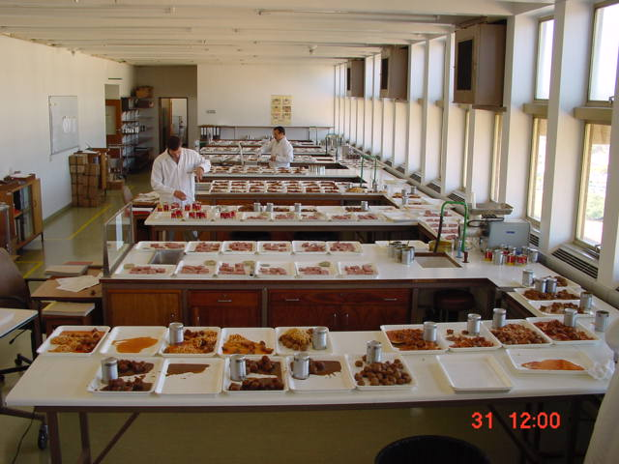
SANS Requirements
Factory Requirements
Hygienic Design
Equipment
Microbiological requirements
Hygienic Operating requirements
Requirements for Employees
Requirements for Ingredients/Product
Marking/Labelling of Product

Slide 10
SANS Requirements
Some key requirements
Floors and drainage
Ventilation
Footbaths
Hand-washing facilities
Separation of processing areas
Facilities for cleaning and disinfection
Effluent & waste disposal and removal
Water/ Ice control
Vermin control
Employee health
Protective clothing
Personal hygiene
Efficacy of cleaning

Slide 11

Processed meat products -Class Examples
Gammons, pastrami, cooked silverside, roast beef (cured), country ham, edible whole muscle offal i.e pickled tongue-VC category(a)
2. Roast pork, roast beef (uncured)-VC category(b)
6. Emulsion products (viennas, polonies, smokies)-VC
category(c)
10. Chicken viennas, fully cooked burgers/polonies
VC-category(d)
10. Reformed hams, chicken, turkey rolls-VC category(e)
9. Salamis- VC category(g)
Unspecified processed meat products-VC category(f)

Slide 12
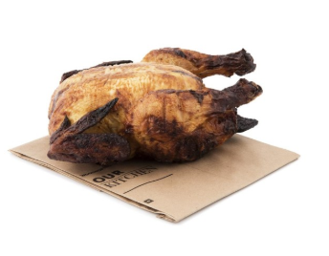
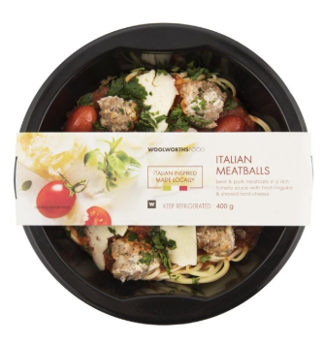
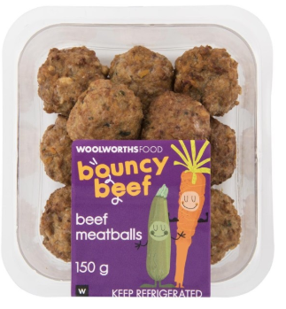
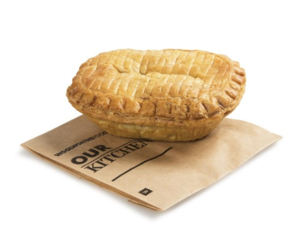

Products not resorting under scope
Rotisserie Chicken
Ready to heat meal with heat treated meatballs
Heat treated meatballs with 29 % hidden veg
READY to eat heat treated meat pies
Ready to eat (heat treated) kebabs

Slide 13
Sampling plan
Monitoring
Market surveillance
Risk based approach
Risk management

Slide 14
Testing of Product
Service level agreement with certain accredited microbiology laboratories(ISO 17025)
Other accredited microbiology laboratories are also accepted if tests are accredited and prescribed by the Compulsory Specification.
Laboratories are state owned entities or privately owned.

Slide 15
Inspection plan
Risk Based Approach
6 monthly summary physical inspection-including HACCP Plan
Line inspections and verification of operations
Annual Food safety verification-including physical inspection
Unannounced Inspections

Slide 16
NRCS Inspection System
  HACCP CONTROLS
  Evaluation of HACCP Plan, Hazard analysis, risks, validation of CCP’s- cooking, cooling, mixing
  Verification of CCP’s
  Physical Verification of processing flow-diagrams
  Verification of Regulatory hazards –trace-ability and labelling of products
  Physical inspection of facility covering all areas- drainage, ventilation, waste control
  Verification of Good hygienic practices of staff-hand washing, protective clothing, medical records
  Operation and Sanitation -Cleaning of factory, equipment
  PROCESS CONTROLS
  Temperature measurements of raw material and other checks
  Composition checks and ingoing ingredients as per recipe
  Process control-Calibration and verification of equipment
  Temperature recorders
  Storage of final product
  Approval and storage of cleaning chemicals, packaging materials, ingredients
  Product appearance and freshness
  FACILITY CONTROLS
  Inspection of ablution facilities, comfort facilities,
  Ingredients stores, including water treatment equipment,
  Ice production facilities

Slide 17
Key focus areas-Microbiological requirements
Process hygiene criteria
Food hygiene criteria
Process hygiene indicators-E. coli, Staphylococcus aureus , TVC and Clostridium perfringens
Food hygiene indicators- Listeria and Salmonella
SANS 885:2011- LM 100cfu/25 g
Draft SANS 885:2019- LM limit of nil cfu /25 g
SANS 885

Slide 18

Dynamics of L. monocytogenes
Global presence
Invasive and persistent
Strain variability
Variable infective dose
Inhibited by salty environments

Slide 19
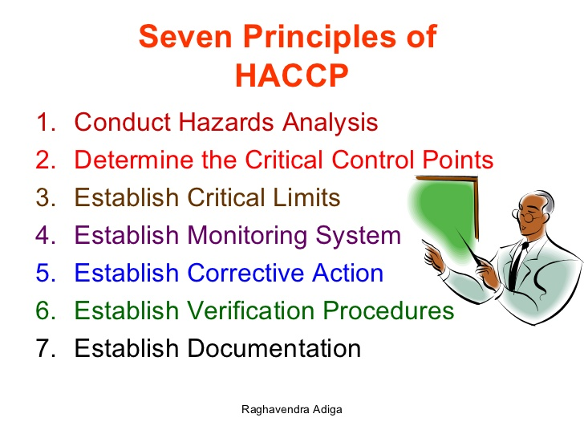
Key focus area- Food Safety Management

Slide 20

Key focus area- Food Safety Management
Food safety management system verification
Management Commitment & Responsibility
Food Safety Policy
Management Review
Internal Audits
HACCP team, meetings and minutes
HACCP Plan
Hazard analysis
Determination of Control measures
Control of CCP’s
Corrective & Preventative actions

Slide 21
Key focus area- Food Safety Management
Pre-requisite Program elements
Documented Methods and Procedures
Control of QMS and Documents& Records
Training
Calibration& Verification of equipment
Pest Control
Product identification& Traceability
Product recall-mock recall
Food defense

Slide 22
Conclusion
NRCS accredited to ISO 17020 ensuring demonstrated competency of Management and inspectors
Implementation process will be completed in phases
All factories to be registered and approved
Cooperation by industry vital for effective implementation

Slide 23
Geographical spread
Number of processed meat facilities
(Filtered for high risk processed meat products)

Slide 24

Levy Coverage
Risk Based approach informs enforcement and compliance activities
Schedule and adhoc inspections for processing facilities
Products monitoring for Microbiological and chemical testing
Physical inspection of final product
Human Resource cost
Training and awareness workshops

Slide 25
Regulatory Cost and Levy Proposal

Slide 26
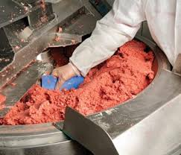


FINAL Q & A
Thank You

