Slide 1
WELCOME TO THE NRCS FAI LEVY CONSULTATION SESSIONS 1 OCTOBER 2019

Slide 2
NRCS FAI LEVY CONSULTANTS OCTOBER 2019

Slide 3
NRCS Officials
Ms. Abigail Thulare
Chief Operations Officer - Apology
Ms. Mimi Abdool
Chief Financial Officer
Ms. Meisie Katz
General Manager FAI
Ms Eunice Sothoane
Accounts Receivables Manager

Slide 4
Agenda
Strategic Overview of the NRCS
NRCS Operational Performance
NRCS Financial Performance
Fee and Tariff Proposals

Slide 5
STATEGIC OVERVIEW OF THE NRCS
NRCS MANDATE
Administer compulsory specifications/ technical regulations in the interests of public safety and health or for environmental protection and ensuring fair trade.

Slide 6
Legislative Mandate
Mandate of the NRCS is derived from the following Acts

Slide 7
NRCS ACTIVITIES
Pre-market approval of NRCS regulated products
Before regulated commodities enter the market, approval granted based on compliance to the administrative requirements and technical compliance as per test reports, certificates of conformity or own testing
The NRCS issues certificates (Letters of Authority, Homologation or Type Approval certificates)
NRCS conducts Market Surveillance Inspections
Inspectors visit manufactures, importers and retailers to inspect and if needed sample products
Inspections are meant to eradicate non-compliances
Sampling and testing
Sampling is done to establish compliance or non-compliance
To retain evidence in the form of a sample
Sanctions
If non-compliance is proven, enforce corrective action and/or recall and/or return to country of origin and/ or destruction and/or notify the media and public

Slide 8
NRCS Strategy, Mission and Vision
NRCS Strategic Goals
Mission & Vision
To ensure an optimally capacitated institution
To develop, maintain and administer compulsory specifications and technical regulations
To maximise compliance with all specifications and technical regulations
To inform and educate our stakeholders about the NRCS
Mission
Vision
A credible and respected regulator for the protection of the public, the economy and the environment
To develop compulsory specifications and technical regulations, and maximise compliance of regulated products and services

Slide 9
Regulated Industries
Industry Sector | Product regulated / Service rendered
Automotive | Vehicles, Replacements components, Manufactures Importers and Builders
Chemicals, Materials and Mechanicals | Building materials ( Cement, treated timber, safety glass & glazing material), Chemicals (disinfectants & detergent-disinfectants), Micro-biological safety cabinets, Personal Protective equipment ( Swimming aids, personal flotation devices, respirators & Safety footwear), firearms & shooting ranges, plastic carrier bags, cigarette lighters, non-pressure paraffin stoves & heaters, pressurized paraffin appliances
Electro-technical | Electrical appliances and products, Electronic appliances and products
Food and Associated | Fishery products, canned meat and processed meat
Legal Metrology | Measurable products and services, measurements in trade, health, safety and the environment, any measuring instrument used for a prescribed purpose and gaming equipment
Building Regulations | Ensure uniform interpretation of National Building Regulations and Standards Act, administer review Board

Slide 10
Challenges and Strategies
Challenges
Inadequate testing facilities in South Africa for some regulated products e.g. Motor cycle helmets.
Capacity constraints, given resources available
Escalating cost of regulation
Importation of products without NRCS Approval
Generation of revenue reliant on trends and markets.
Non-compliant levy payers
Internal control weaknesses – ICT system
Strategies
SARS & NRCS Collaboration (Code alignment project)
NRCS and other government departments & entities
System modernisation
Border enforcement
Levy collections and under-declarations
Meeting the current LOA turnaround times

Slide 11
NRCS Highlights
IPAP: Lock in and Lock out principles implemented
Non-compliant products to the value of R319 million were removed from the market.
The NRCS conducted 50 178 inspections
The NRCS issued 17 656 approval certificates for Electro-technical (72%), Automotive (24%) and Chemicals, Materials and Mechanicals (3%) , (1%) for Measuring Instruments products
Issued 12087 health guarantees which ensured that all exported fishery and associated products were accepted in foreign markets.
Issued 9239 compliance certificate for imported products
Corporate social investment (Safe paraffin stove campaign)
Levy Audit successes (R22mln in FY 2018/2019)

Slide 12
Financial Performance

Slide 13
Financial Status: Income Statement

Slide 14
Financial Status: Revenue

Slide 15
Statement of Financial Position as at 31 March 2019
 | 2019 | 2018
Revenue | 437 260 002 | 480 688 210
Expenditure | -562 776 910 | -346 405 618
Surplus / (Deficit) | -125 516 908 | 134 282 592

Slide 16
Levy Audit Qualification
Levies are Incomplete/ Inaccurate which results in NRCS audit qualifications:
Bona fide error
If a levy payer has incorrectly classified the levy commodity which they import or manufacture a bona fide error has been made. Lists of regulated products are available on the NRCS website www.nrcs.org.za and technical specialists are available to advise.
Under-Declaration
The NRCS has the right to request any information it deems necessary for a period of five years.
If under-declaration is suspected please notify a Levy Officer. A Levy Auditor will appointed to investigate.
Non-Submission of Returns
As at the end of March 2019, 10 -15 % of the levy returns due to the NRCS had not been submitted yet. 100% achieved through estimate as per NRCS Act.
Penalty
NRCS will levy a penalty charge of R500 to all late submission and non-submissions as of 1 January 2019.
A levy is the equivalent of a tax
If the NRCS does not recognise all levies due to it, its revenue is incomplete
A combination of levy audits and follow up on outstanding levies attempts to address this

Slide 17
Plans to address the Audit Qualification
The NRCS Plans in 2018/2019
Updating all customer information;
Issuing of the declaration forms to all customers and sending reminders;
Forms are available on the NRCS website;
Inspectors assisting customers to register, return the forms during the site visits;
Ensuring customers submit their levy declarations and make payment within 30 days during the LOA application process;
Estimation of non-compliant customers;
To ensure all customers submit the mandatory quarterly declaration forms (please refer to next slide);
To charge a penalty of R500.00 per mandatory submission in case of non or late submissions as per the NRCS Act as of 01 January 2019.

Slide 18
Annual Levy Declaration: Deadlines

Slide 19
Financial Matters
Successes
Strengthened Levy Audit functions
Compliance check on applications (Levy, Debtors, Fees)
Challenges
Some clients in the industries are none compliant (levy declarations, payment)
Some clients do not declare their levy commodities in full.
A small percentage of clients do not split their quarterly declarations.
In most cases clients will make a payment without also sending the completed levy return form.
Some clients will declare Nil Returns every year even after an LOA has been issued.
Adverse economic conditions
Declining government funding
Financial strategy aligned to the NRCS strategy and mandate – 100% cost recovery
Key Strategies
Automation of the NRCS levy declaration function
Levy audit focus on non compliance (under-declaration, incorrect declaration, non-declaration)
Email statements
To ensure all business units 100% recovery, FAI deficit and plans to return to breakeven

Slide 20
Increases for the 2019-2022 Financial Year
2018/2019 Increase
Minister gazetted an of increase of 4.9% on 3rd May 2019 in lieu of the 2018/2019 financial year;
Based on CPIX;
Effective 1 July 2019 – December 2019.
Proposed Increases 2019 to 2022 for FAI and Processed Foods
Direct costing is 5%;
Re-costing of the scales

Slide 21
FOOD AND ASSOCIATED INDUSTRIES: FEES

Slide 22
FOOD AND ASSOCIATED INDUSTRIES: FEES

Slide 23
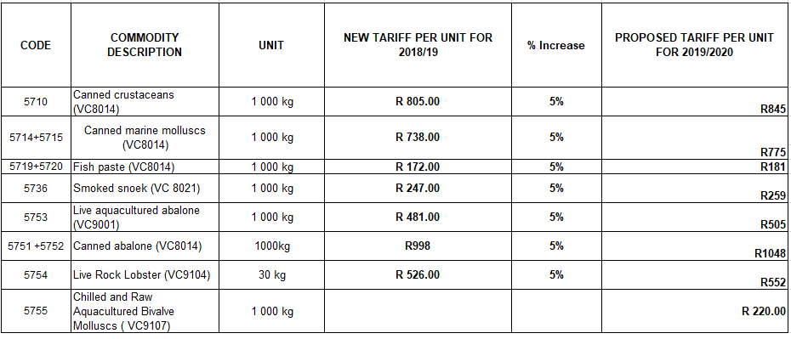
FOOD AND ASSOCIATED INDUSTRIES: LEVY TARIFFS 2019-2020
Single tier scale that has direct adjusted by 5%

Slide 24
FOOD AND ASSOCIATED INDUSTRIES: LEVY TARIFFS 2019-2020

Slide 25
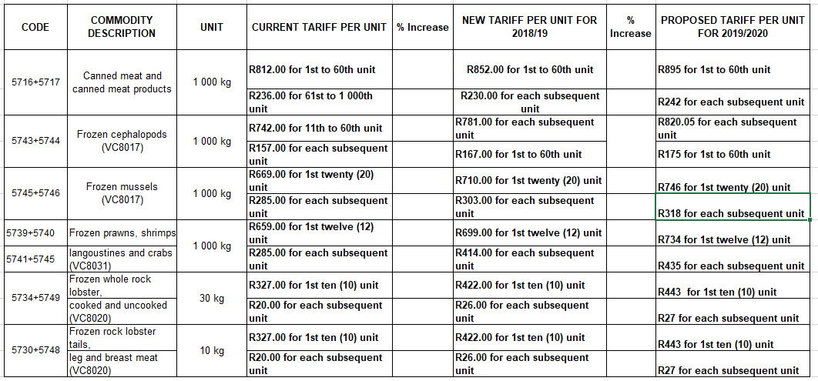
Proposed Increases - FAI
Two Tier sliding scale the - adjustment of scale costing

Slide 26
Proposed Increases - FAI
Two tier sliding scale - the adjustment of scale costing

Slide 27
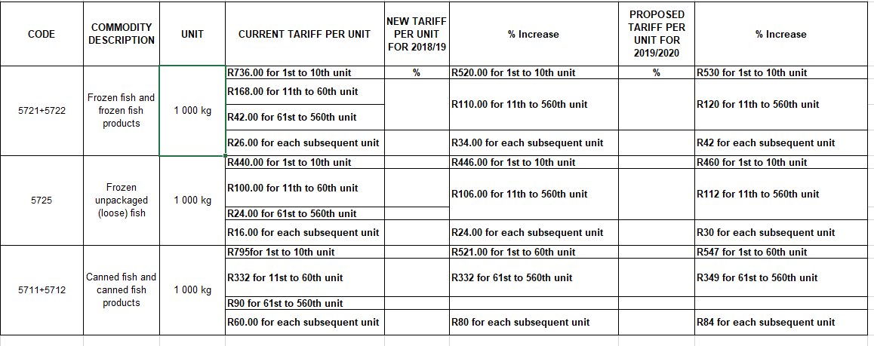
Proposed Increases - FAI
Three Tier sliding scale the - adjustment of scale costing

Slide 28
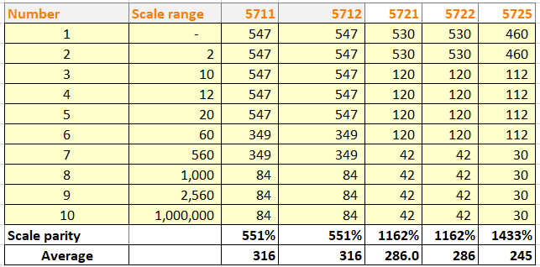
Proposed Increases - FAI
Three tier sliding scale – the adjustment of scale costing

Slide 29
Example

Slide 30
NRCS LEVY CONSULTATIONS
Thank you
Questions

